Slide 1
Creating StationXML:
Introducing Yasmine and the New Nominal Response Library Web Service
SAGE/GAGE Community Science Workshop
Short Course, June 13, 2022
Pittsburgh, PA

Slide 2
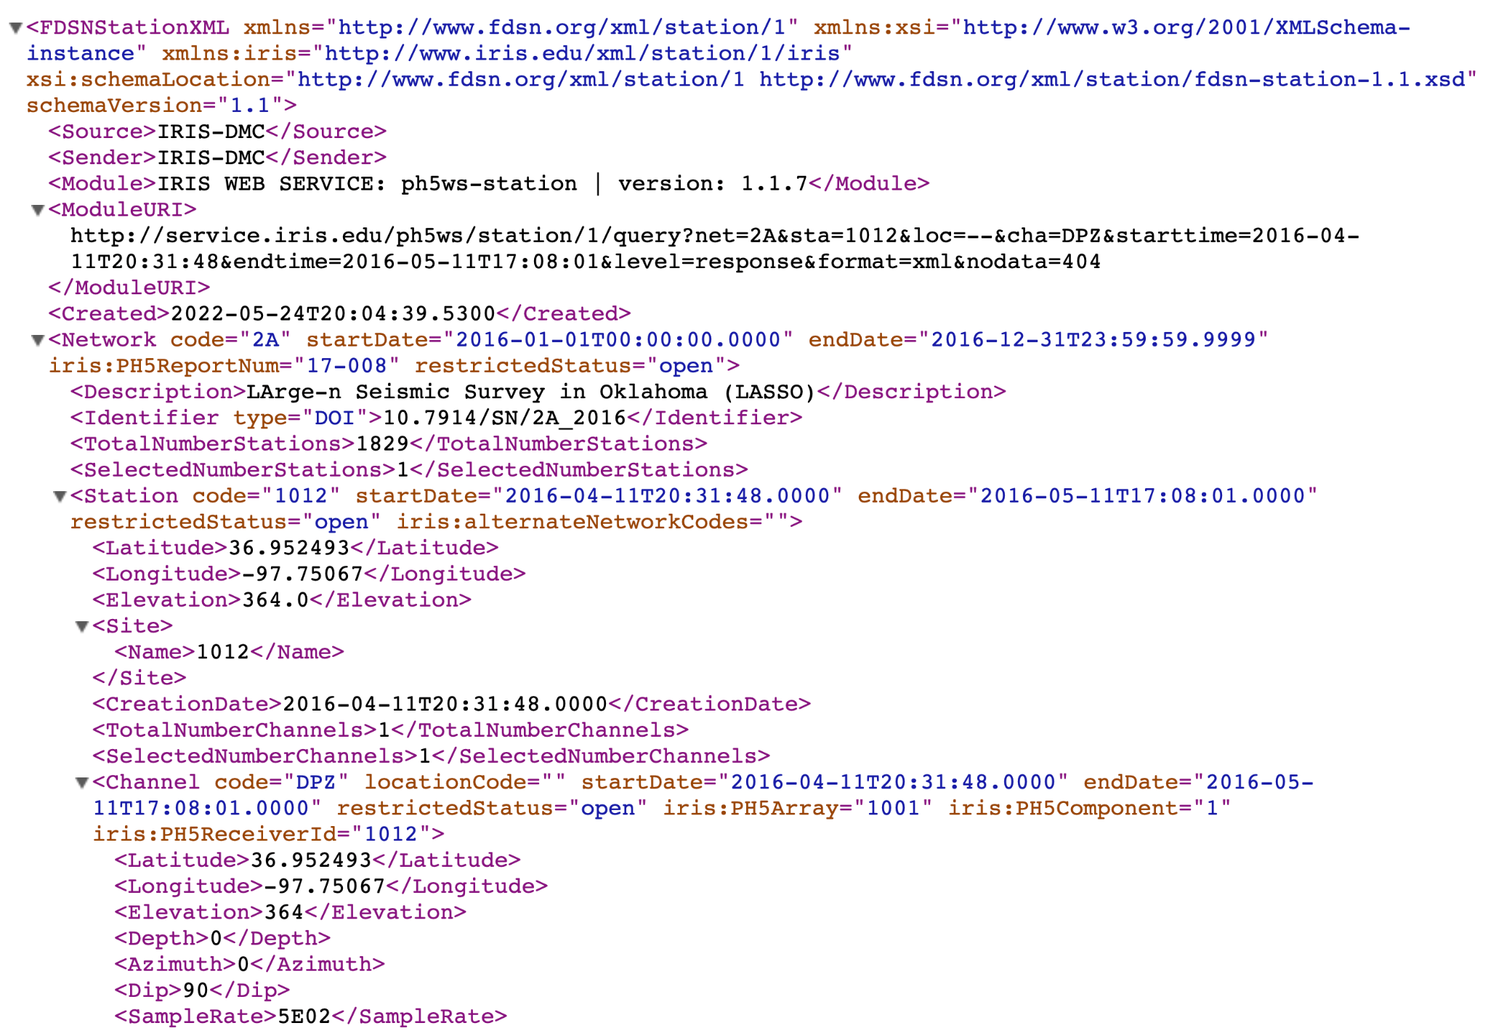
What is FDSN StationXML?
StationXML is a standardized XML metadata exchange format for seismic data
Successor of dataless SEED 2.4
Developed by the International Federation of Digital Seismographic Networks (FDSN)
https://www.fdsn.org/xml/station/
Notes:
SEED - Standard for the Exchange of Earthquake Data
StationXML takes the most common and important dataless SEED fields and adds extensions
advantages of StatonXML vs SEED?

Slide 3
Levels of FDSN StationXML Detail
XML has a hierarchical structure
Network
→ Station
→→ Channel
→→→ Response
Notes:
Nested

Slide 4
IRIS Nominal Response Library: The NRL

Slide 5
What is the NRL?
The NRL is a library of manufacturer’s recommended nominal responses that is compiled, maintained, and distributed by IRIS
Responses are generated from manufacturers documentation or direct communication and checked for
reasonable response curves
correct gain, FIR filter delays, and other attributes
format validity
Currently contains over 23,000 responses from 35 sensor manufacturers and 29 datalogger manufacturers
Notes:
define nominal

Slide 6
What is new for the NRL?
Version 2 was released in April 2022!
Access the Library through the web service:
https://service.iris.edu/irisws/nrl
Access the Library through a new web page:
https://ds.iris.edu/ds/nrl
Responses available as StationXML in addition to SEED RESP format
also available as a response-only subset of FDSN StationXML 1.1 that we are calling StationXML-Response
New response types: integrated recorders, state-of-health channels, polynomial response descriptions

Slide 7
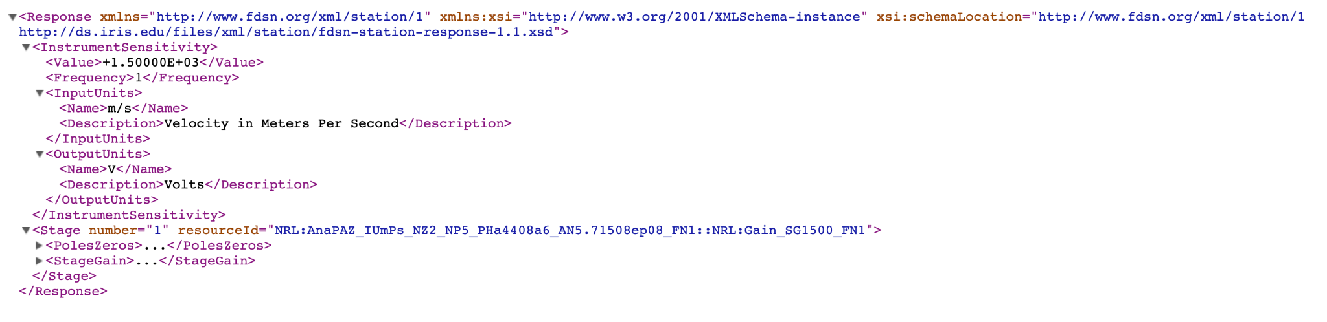
More about the StationXML-Response format
Schema available here: https://ds.iris.edu/files/xml/station/fdsn-station-response-1.1.xsd
Example:

Slide 8
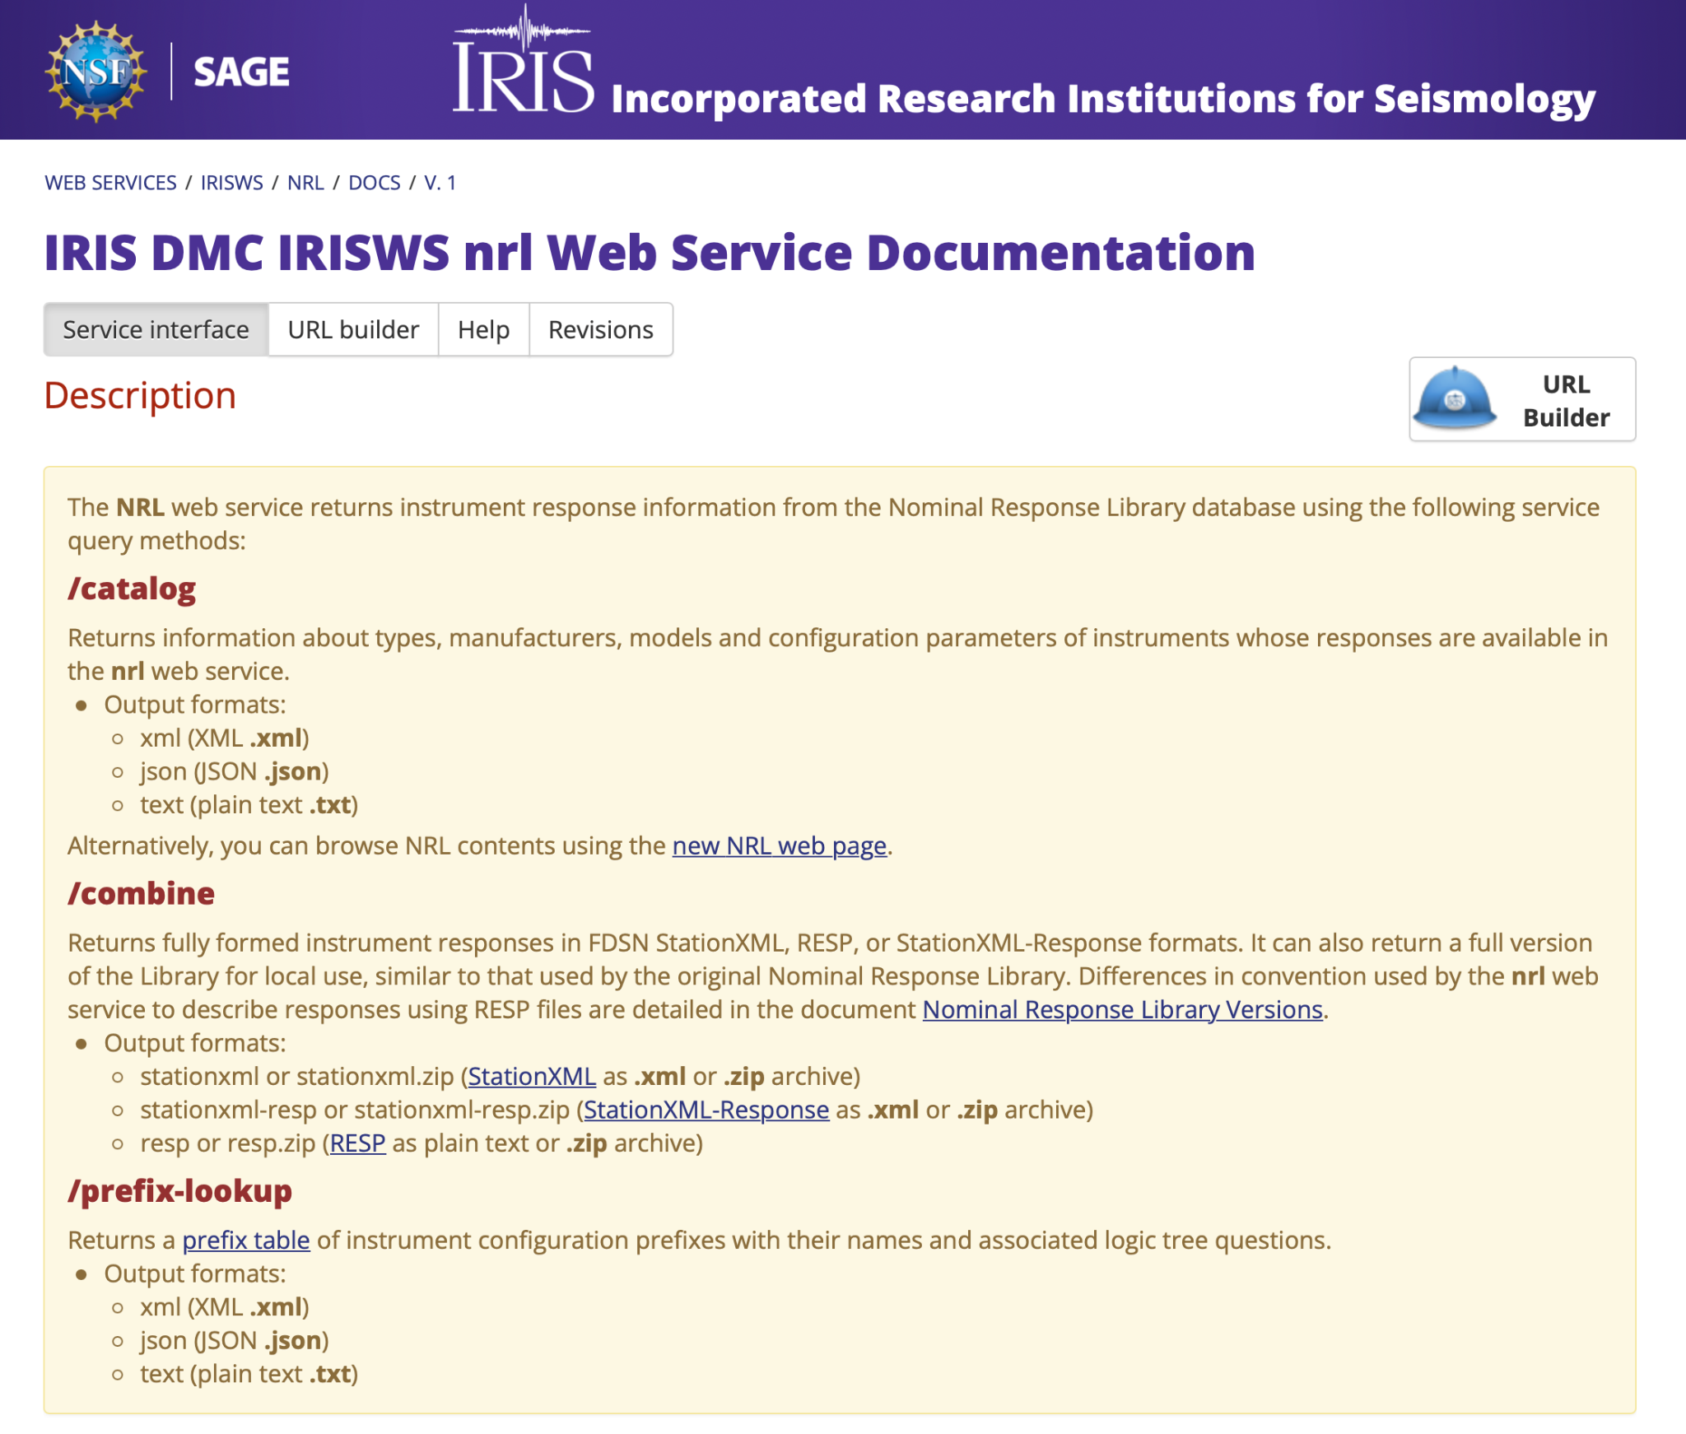
NRL v2: Web Service service.iris.edu/irisws/nrl/1

Slide 9
Levels of Information
Element
response element type: datalogger, sensor, integrated, soh
Manufacturer
instrument manufacturer: e.g., Geotech, Guralp, Kinemetrics
also available: GenericUnity; for retrieving generic unity responses
Model
instrument model: e.g., KS-2000, CMG-5T, Obsidian
also available: UnityDatalogger, UnityVelocity, UnityAccelerometer, UnityPolynomialPA; for retrieving generic unity responses
Configuration
parameters that describe the instrument settings and other information identifying the response

Slide 10
Configurations: Instconfig and Prefixes
the instconfig is a string that uniquely identifies the response
comprised of element, manufacturer, model, and parameters
e.g., datalogger_Agecodagis_Kephren_PG2_FR1000
configuration parameters are described by two character prefixes followed by values
e.g., PG2 refers to a preamp gain value of 2
FR1000 refers to a final sample rate of 1000 Hz
Notes:
It will help a first-time user to repeated link “configuration” with “parameters” - e.g. “configuration parameters are described…”

Slide 11
Configurations: Prefix-Lookup
Table describing all the Prefixes used in the Instconfig strings are available through the web service /prefix-lookup endpoint
http://service.iris.edu/irisws/nrl/1/prefix-lookup?format=text
(other format options are JSON and XML)

Slide 12
Exploring What is in the NRL: Catalog
The /catalog endpoint displays information about what responses are available through the NRL web service
filter by element, manufacturer, model
display by level of information: element, manufacturer, model, configuration
the configuration level includes the instconfig and a human-readable text string describing the instconfig
output formats: JSON, XML, Text
JSON and XML include version date, parameter elements, and a “Detail” element that contains information helpful for response selection

Slide 13
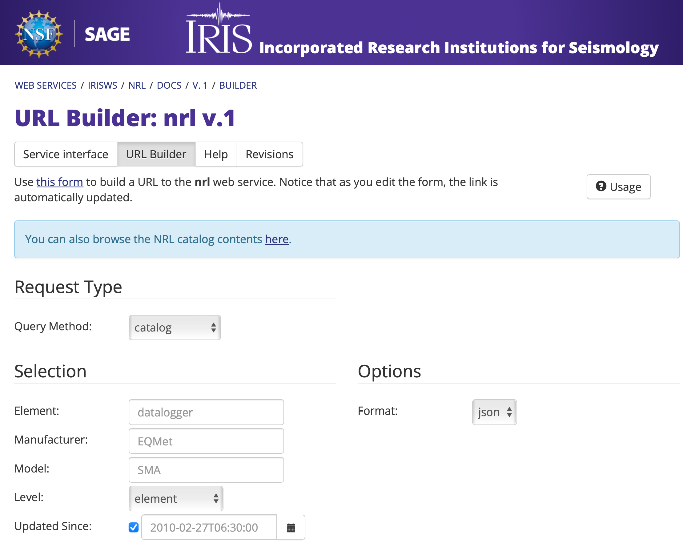
URL Builder Demo: Catalog Endpoint

Slide 14
Retrieving Responses: Combine
The /combine endpoint is where you request response files
select responses by instconfig, element, manufacturer, model
output formats:
format=stationxml returns a single XML document for a single response
requests for multiple responses will not succeed
format=stationxml.zip returns a ZIP file of one or more XML documents
also: resp, resp.zip, stationxml-resp, stationxml-resp.zip
where stationxml-resp is abbreviated for stationxml-response

Slide 15
Retrieving Responses: Combine
The /combine endpoint can also combine responses of two instruments to create a single cascaded response
e.g., datalogger and sensor combination
for use with instconfig parameter only
join multiple instconfig strings with colon (:)
example:
instconfig=datalogger_Agecodagis_Kephren_PG2_FR1000:sensor_Streckeisen_STS-5A_LP120_SG1500_STgroundVel
instconfig accepts comma-separated lists but not wildcards
element, manufacturer, model accept both lists and wildcards
Notes:
new feature, you no longer need other software to combine instruments into a response
LP120 = long period corner 120 seconds
SG1500 = Sensitivity 1500 V/m/s
ST = Sensor Type

Slide 16
Other Web Service Parameters
epoch options (combine endpoint only):
add network, station, location, starttime, endtime information to the StationXML or RESP output
updatedsince
return only responses that have been added or changed in the NRL since the specified date (00:00:00 UTC)
nodata
specify HTTP status code when no information is returned
204 No Content (default)
404 Not Found
Notes:
Not only can you add epoch information, but you can similarly add station, network, location and channel codes.

Slide 17
Retrieving Responses: Examples
request StationXML for the Agecodagis Kephren datalogger with a preamp gain value of 2 and a final sample rate of 1000 Hz
http://service.iris.edu/irisws/nrl/1/combine?format=stationxml& instconfig=datalogger_Agecodagis_Kephren_PG2_FR1000
request a ZIP file containing StationXML files for each configuration of Agecodagis Kephren datalogger
http://service.iris.edu/irisws/nrl/1/combine?format=stationxml.zip& element=datalogger&manufacturer=Agecodagis&model=Kephren
Notes:
Go to the links, point out the module URI

Slide 18
Retrieving Responses: Examples
request StationXML response for:
Quanterra Q330HR datalogger (preamp gain 1, final sample rate 1, ADC type HR, linear filter rates below 40 and no decimation filter)
combined with
Nanometrics Trillium 240 sensor (electronics generation 2, long period corner 244 seconds, sensitivity 1189, sensor type ground velocity)
http://service.iris.edu/irisws/nrl/1/combine?instconfig=datalogger_Quanterra_Q330HR_PG1_FR1_ADHR_LRbelow40_DENone:sensor_Nanometrics_Trillium240_EG2_LP244_SG1189_STgroundVel&format=stationxml

Slide 19
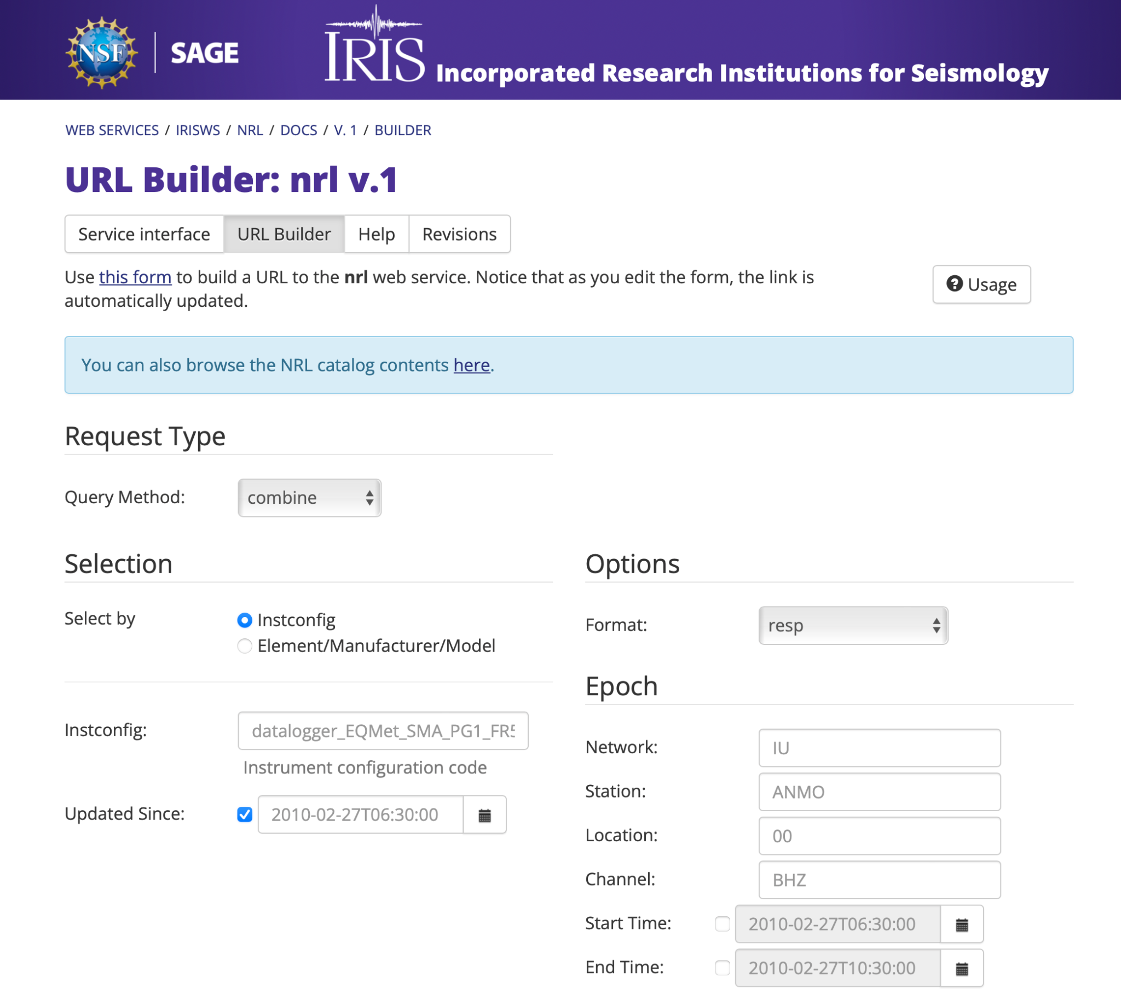
URL Builder Demo: Combine Endpoint

Slide 20
Full NRL ZIP Output from Web Service
The entire NRL is available in a single ZIP file
use instconfig=full_NRL_v2_zip
use format=resp.zip or format=stationxml.zip
http://service.iris.edu/irisws/nrl/1/combine?instconfig=full_NRL_v2_zip&format=resp.zip
http://service.iris.edu/irisws/nrl/1/combine?instconfig=full_NRL_v2_zip&format=stationxml.zip

Slide 21
Differences between Full ZIP file RESP output
NRL Version 1
NRL Version 2
top level subdirectories: sensors, dataloggers
manufacturer directories could have more than one subdirectory
sensor RESP files contain a Stage 2 generic unity datalogger
datalogger RESP files contain a Stage 1 generic unity sensor, Stage 2 preamp, Stage 3 ADC, Stage 4-N FIR and other filter/gain
channel response always contains a sensor (Stage 1) and a datalogger (Stage 2-N)
Units are upper case
top level subdirectories: sensor, datalogger, integrated, soh
manufacturer directories have no subdirectories
sensor RESP files only contain a Stage 1 sensor and no generic unity datalogger
datalogger RESP files do not contain a generic unity sensor. Stages 1-N depend on the datalogger
channel response contains one or more response element types
Units are lower case
full accounting at: https://ds.iris.edu/files/nrl/NominalResponseLibraryVersions.pdf

Slide 22
Plans to Retire Version 1
NRL v1 will be maintained in parallel with v2 until at least Spring 2023
to allow the community time to adapt their metadata software and applications to use the new version
the final retirement date will be set when there is no longer a compelling need for v1
this will take into consideration the success of community adoption

Slide 23
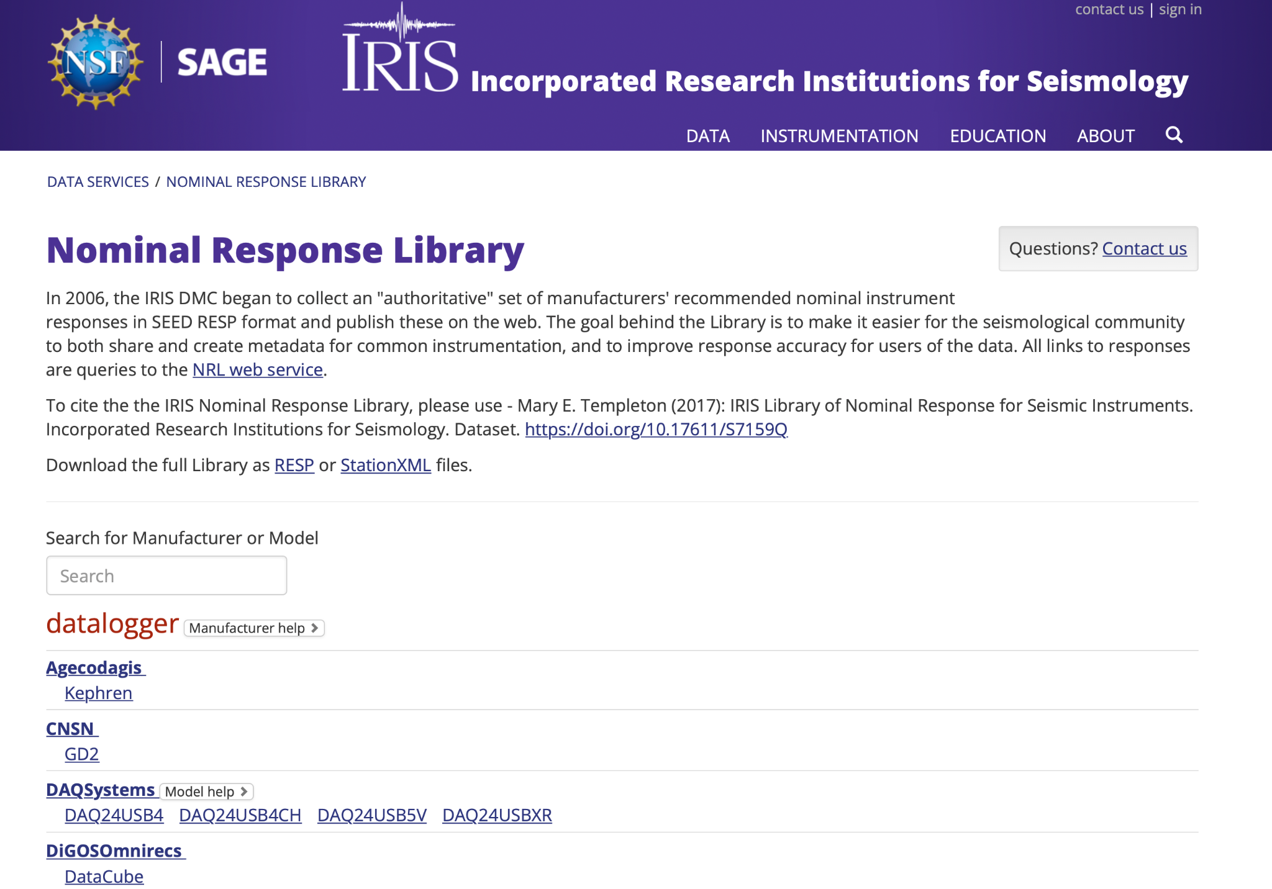
NRL v2: Web Page ds.iris.edu/ds/nrl
Notes:
DEMO

Slide 24
NRL Exercises
Go to the new NRL web page (ds.iris.edu/ds/nrl)
Go to the NRL Web Service URL Builder (service.iris.washington.edu/irisws/nrl)

Slide 25
Yasmine
Yet Another Station Metadata Information Editor
IRIS/RESIF

Slide 26
Yasmine
Yasmine is a general purpose tool for creating, editing, and writing StationXML
Jointly developed and maintained by the Incorporated Research Institutions for Seismology (IRIS) and the French Seismological and Geodetic Network (RESIF)
Intended audiences include network operators, principal investigators, and anyone needing to create StationXML metadata for their seismic instrumentation
Code is in two GitHub Repositories, in beta:
Yasmine Editor: https://github.com/iris-edu/yasmine-stationxml-editor
Yasmine CLI: https://github.com/iris-edu/yasmine-stationxml-cli

Slide 27
Response Sources Used By Yasmine: NRL vs. AROL
The Nominal Response Library (NRL)
Yasmine uses NRL v1, bundled as a .zip file
Has not been updated to use latest version yet (no access to integrated, SOH, or polynomial instruments)
The Atomic Response Objects Library (AROL)
A new instrument response library under development by Résif
Easier, faster selection of instrument configurations
Includes a smaller set of instruments

Slide 28
Running Yasmine Editor
Install Docker Compose, if not already on your machine
to determine if it is installed, try running on the command line:
> docker-compose version
Clone the Yasmine Editor Git repository:
> git clone https://github.com/iris-edu/yasmine-stationxml-editor
Note: If you are running on an Apple M1 machine, uncomment the lines indicating the target platform in the `docker-compose.yml` file.
Run the application:
> cd yasmine-stationxml-editor && docker-compose up
This step may take 10-15 minutes to start up the first time you run the Yasmine Editor while it loads the NRL

Slide 29
Running Yasmine Editor
4a. The first time, look for the following command line output:
> yasmine-frontend | [INF] Waiting for changes...
> yasmine-backend | INFO:yasmine.app.helpers.nrl.nrl_helper:Unzipping NRL
> yasmine-backend | INFO:yasmine.app.helpers.nrl.nrl_helper:NRL has been unzipped
> yasmine-backend | INFO:yasmine.app.helpers.nrl.nrl_helper:Creating an NRL key files
> yasmine-backend | INFO:yasmine.app.helpers.nrl.nrl_helper:NRL key files have been
created
4b. Otherwise, Look for the following command line output:
> yasmine-frontend | [INF] Waiting for changes...
5. Visit http://localhost:1841 in browser window
(to stop Yasmine Editor, run `docker-compose down` on the command line)

Slide 30
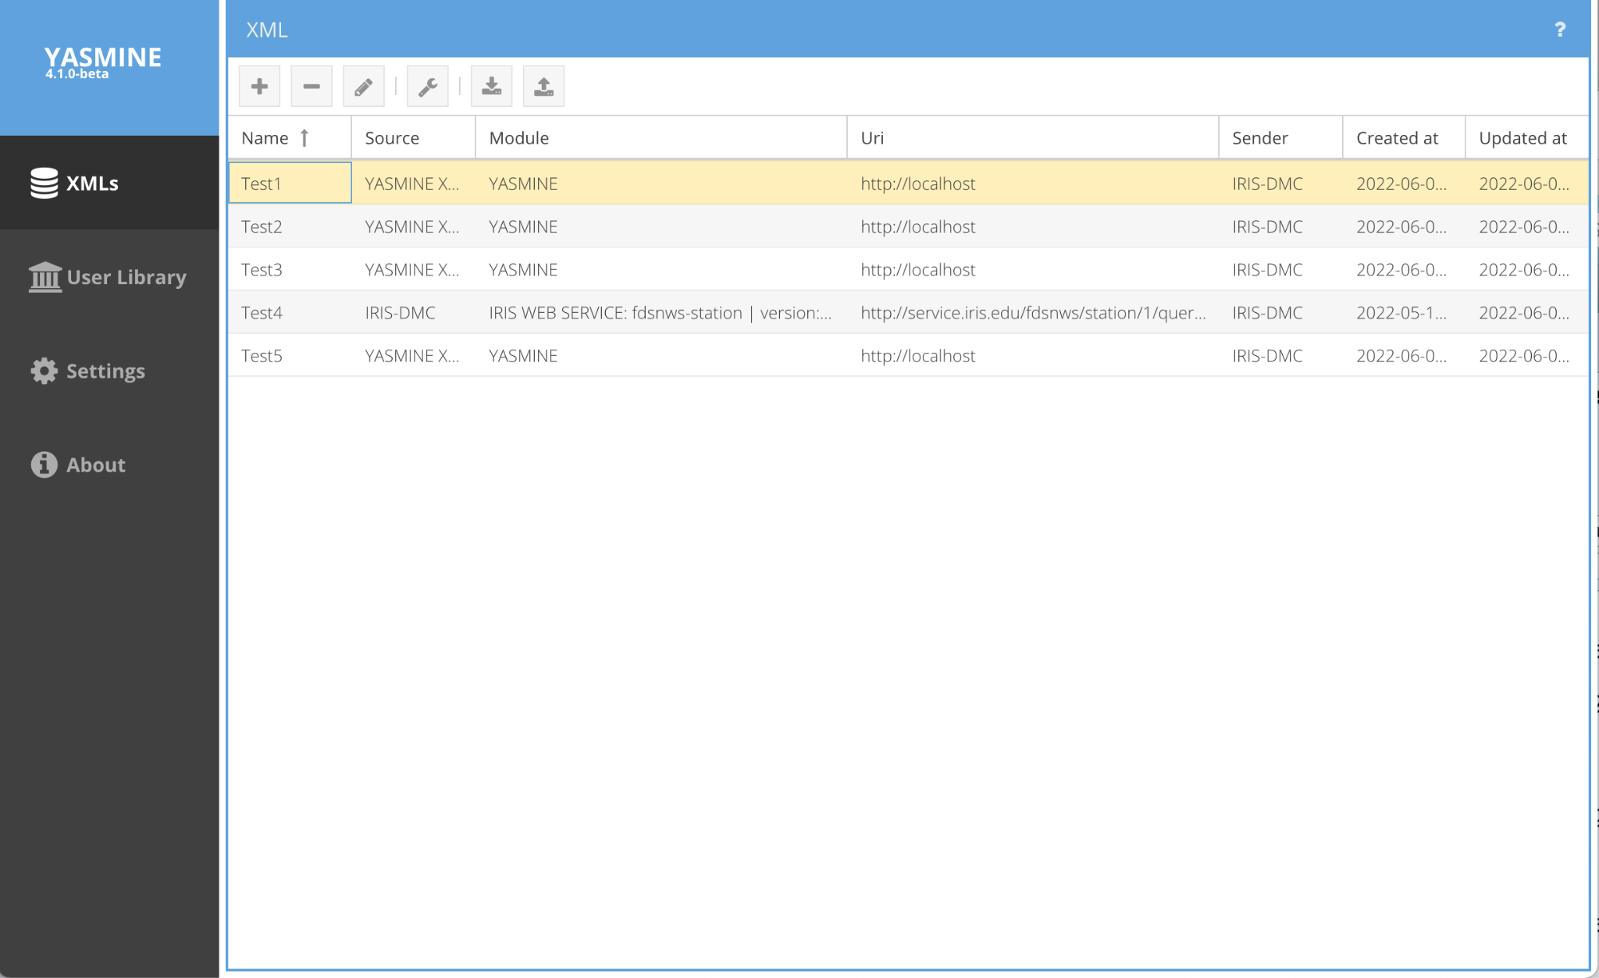
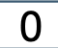
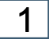
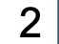
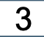
Yasmine User Interface
Main Left Side Tabs
0: XMLs
1: User Library
2: Settings
3: About

Slide 31
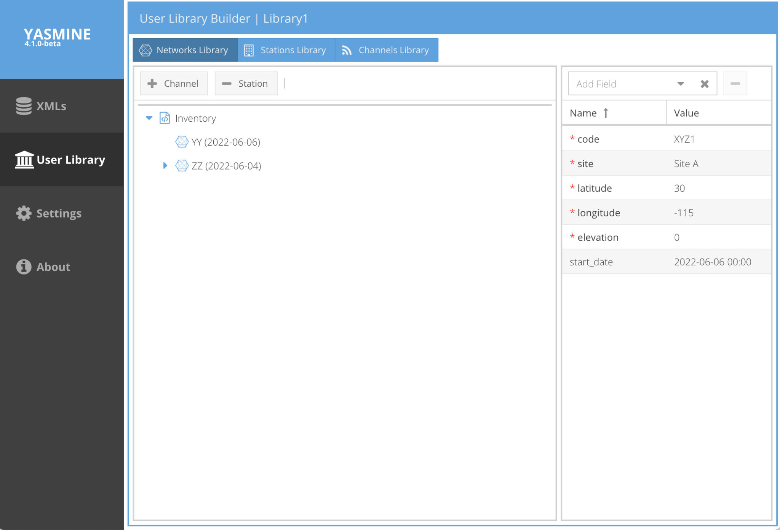

Yasmine User Library
StationXML elements may be saved in the User Library for later reuse and fast prototyping
custom templated or derived from imported StationXML files
Contains three sub-libraries:
Network Library
Station Library
Channel Library
Configuration View
Notes:
What you see when you double-click on a Library name or click on the the Configuration Icon

Slide 32
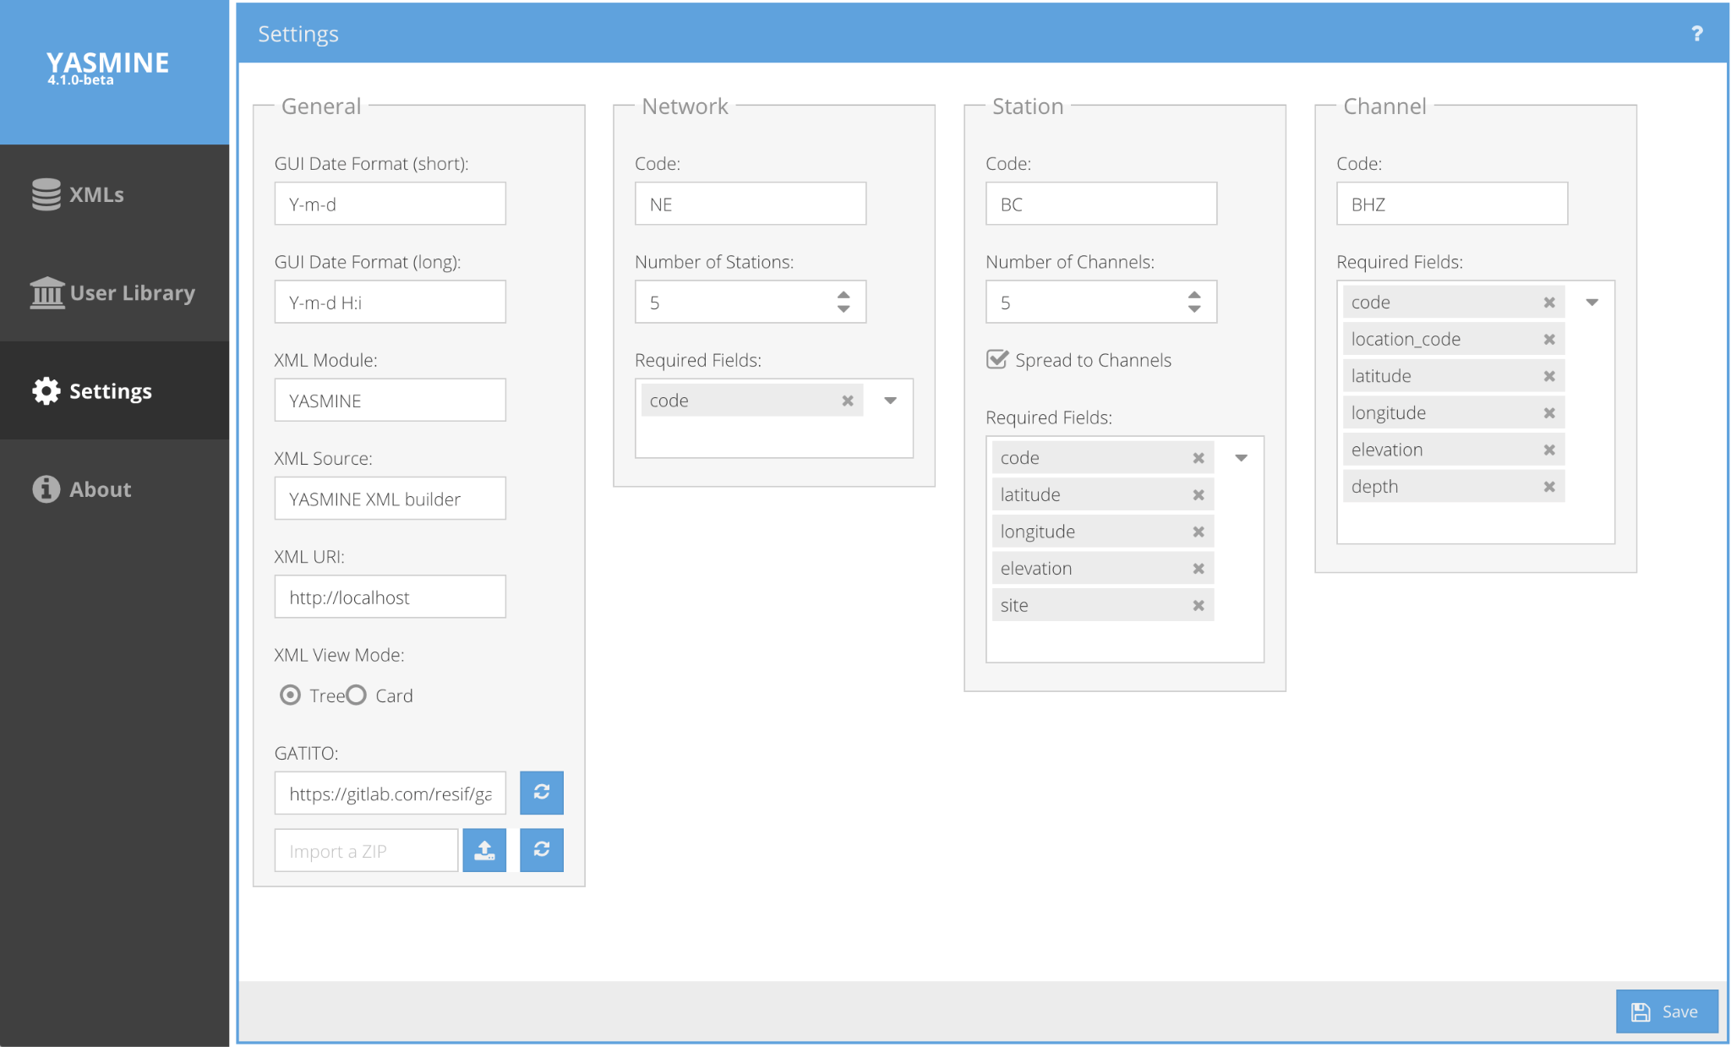
Yasmine Settings
Configures the global behavior of the application
Options include:
General properties
Datetime format
XML Module/Source/URI
XML navigation view
Gitlab repository for AROL responses (GATITO)
Network, Station, and Channel element properties
Required fields
Default codes
Notes:
Generic ATomic TIny Objects

Slide 33
Yasmine XMLs
Main view for manipulating metadata
Import existing StationXML for editing
Create StationXML using Wizard Tool
Create StationXML using a default template
Create StationXML using metadata stored as templates in the User Library

Slide 34
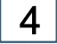

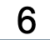

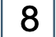
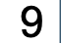
Yasmine XMLs
Top Icons
4: Create XML
5: Delete XML
6: Edit XML
7: XML Builder
8: Import XML
9: Export XML

Slide 35

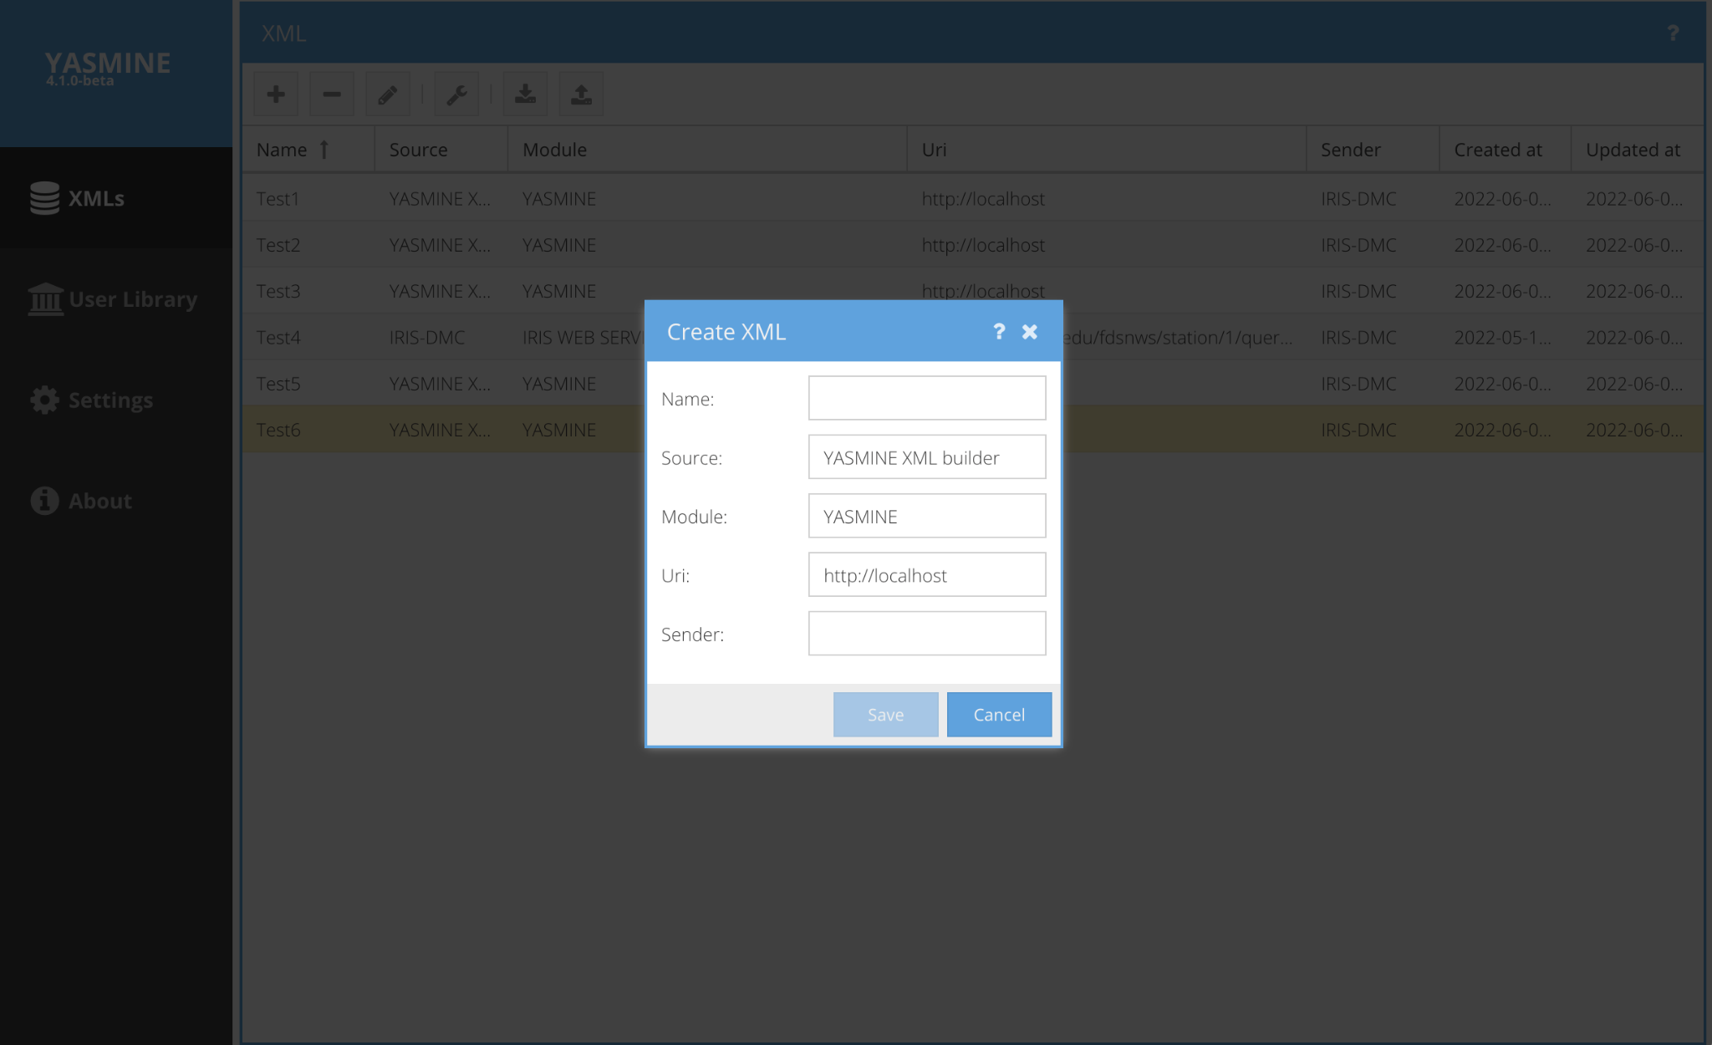
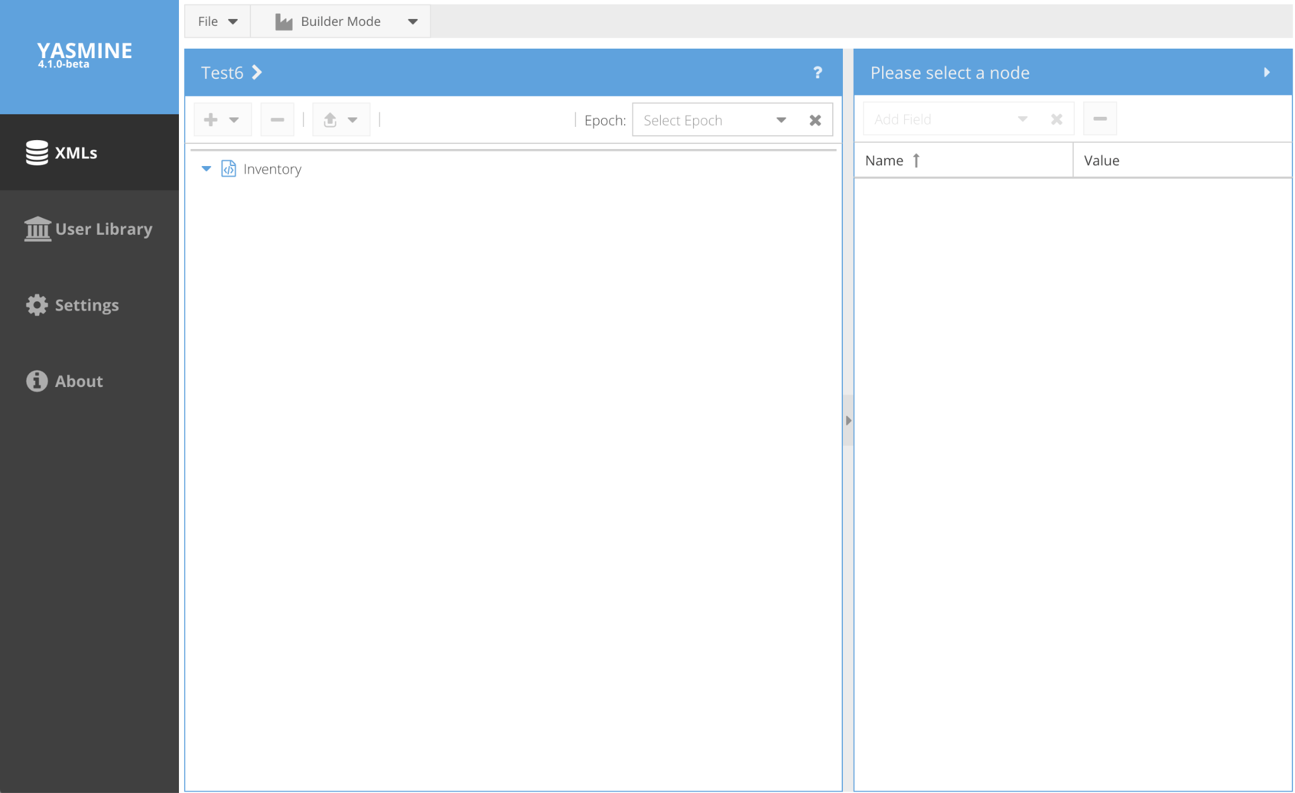
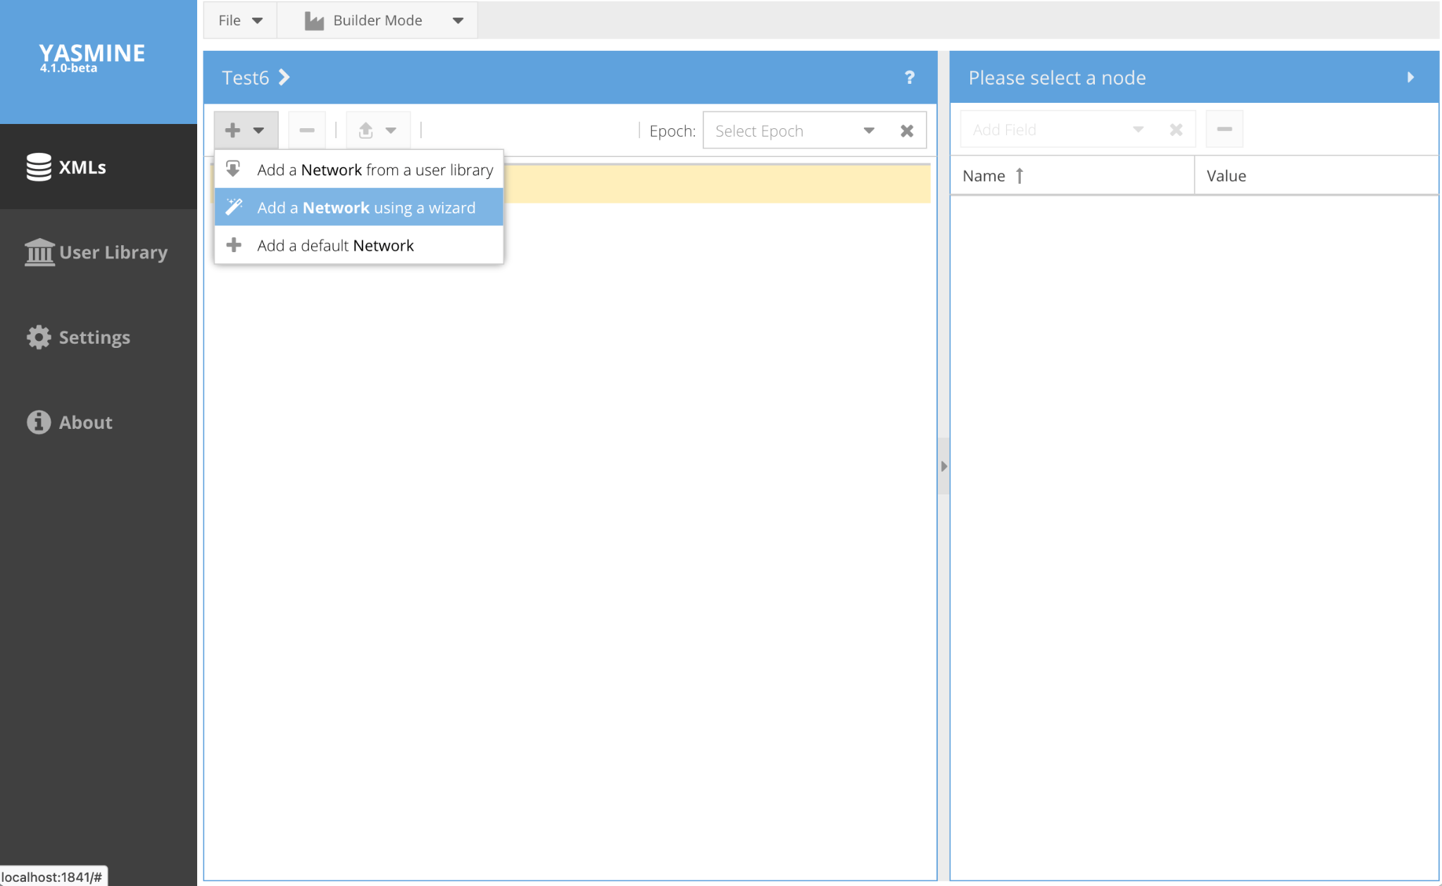
Creating Metadata
Add from Library
Add from Wizard
Add from Default

Slide 36
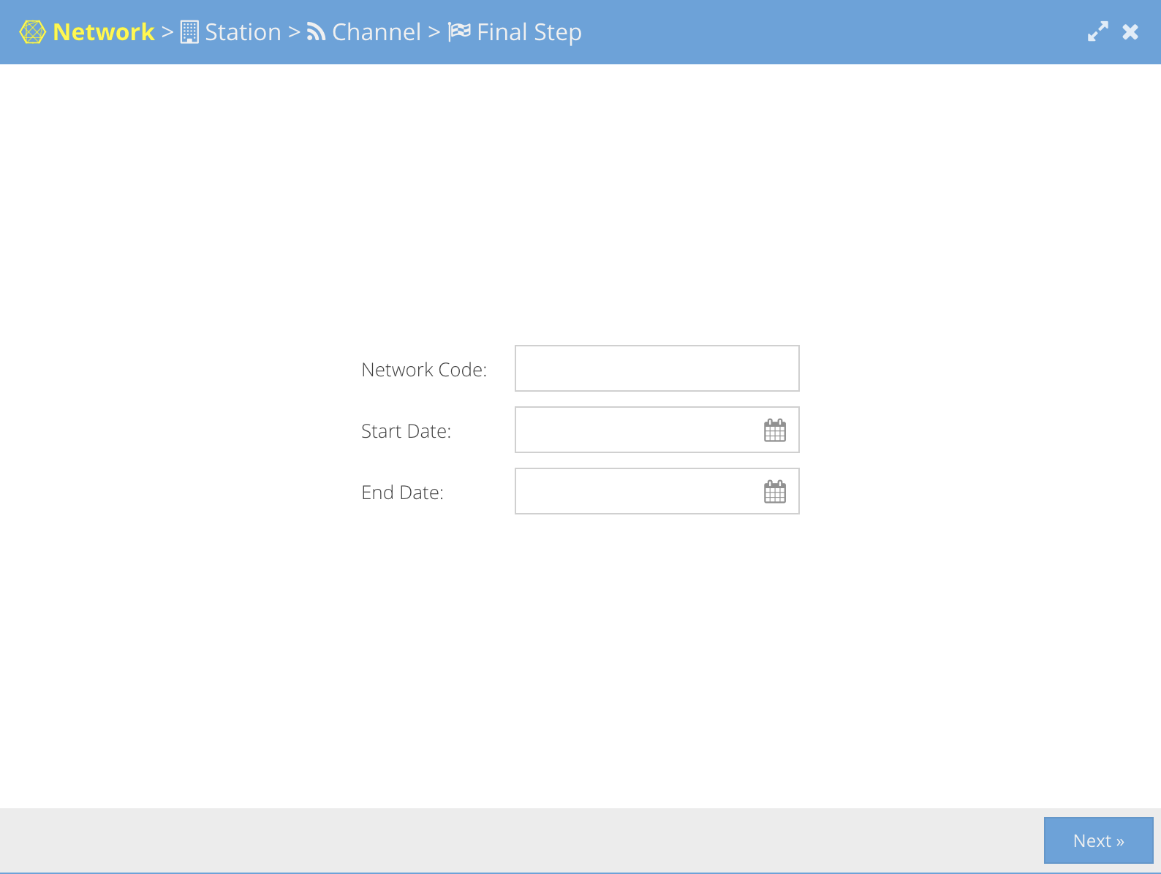
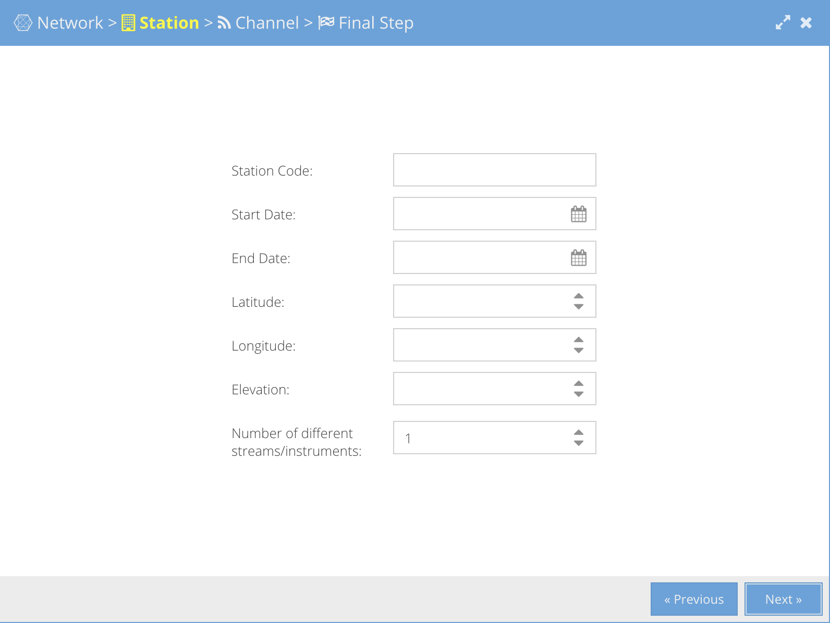
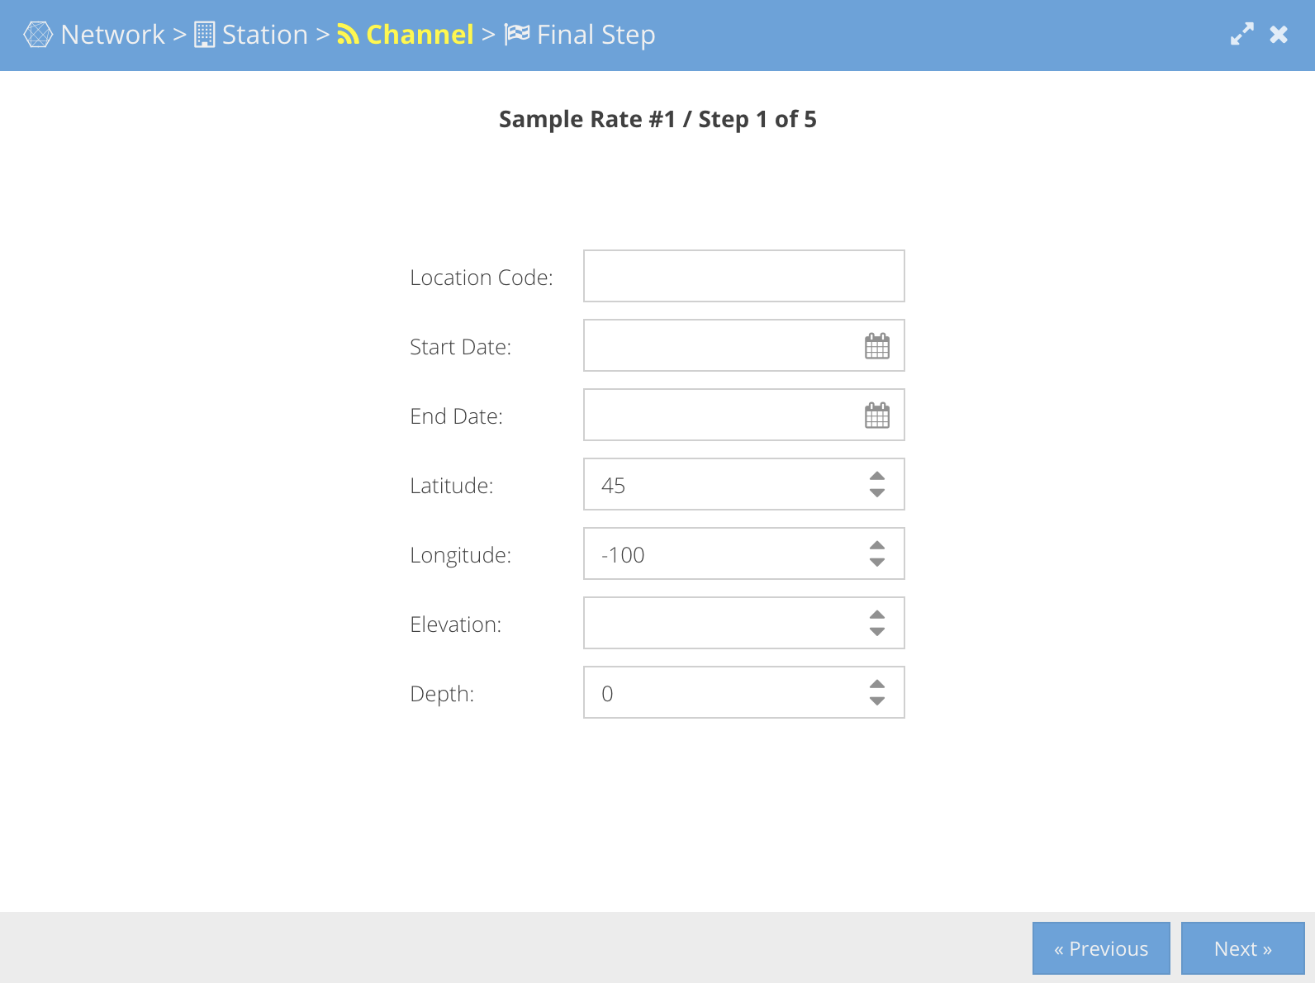
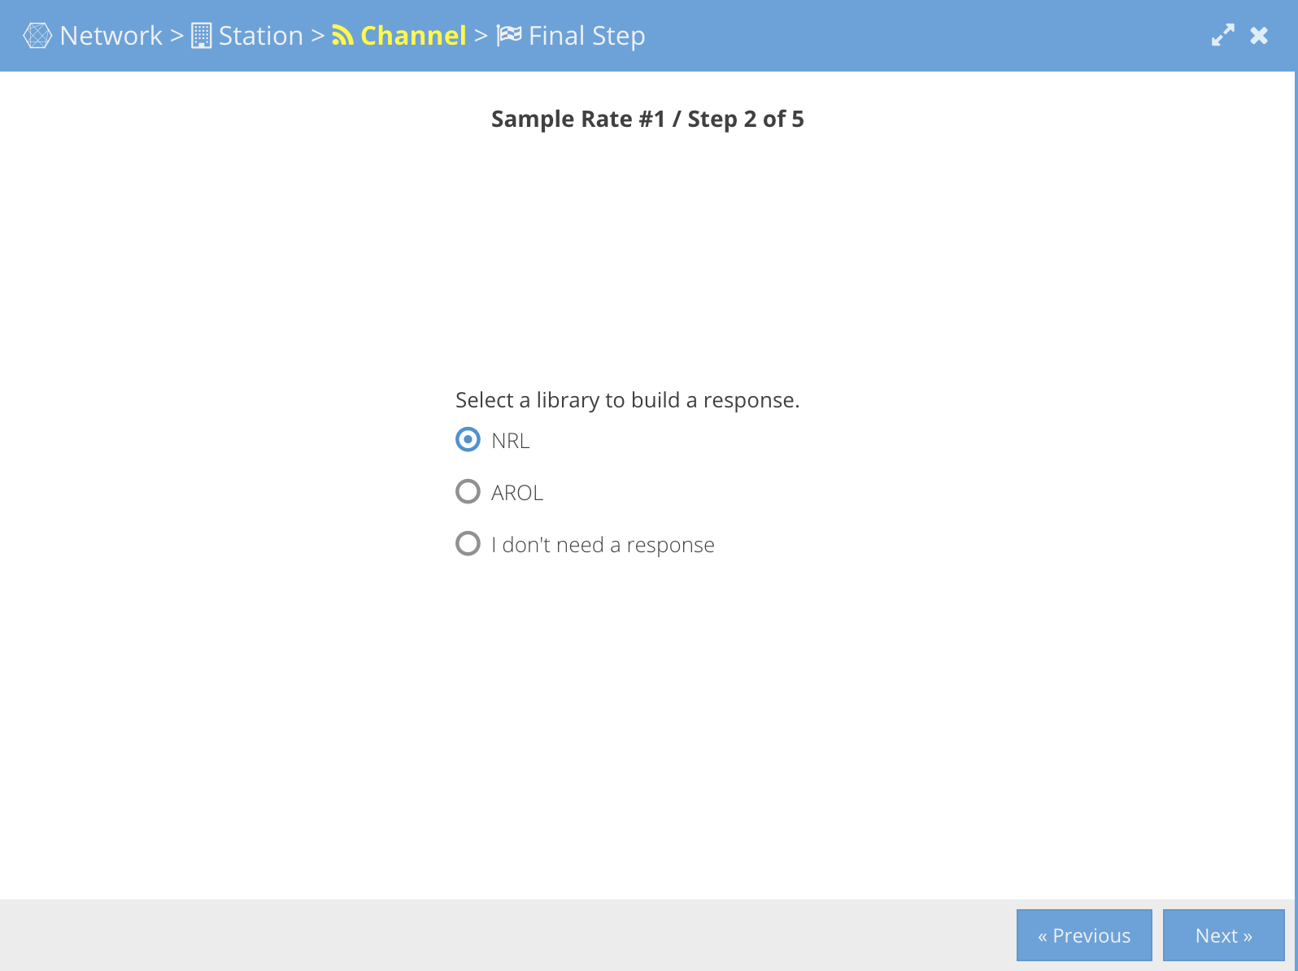
Walking Through the Wizard
Network Level
Station Level
Channel Level
Response Level
Choice of: NRL
AROL
No Response

Slide 37
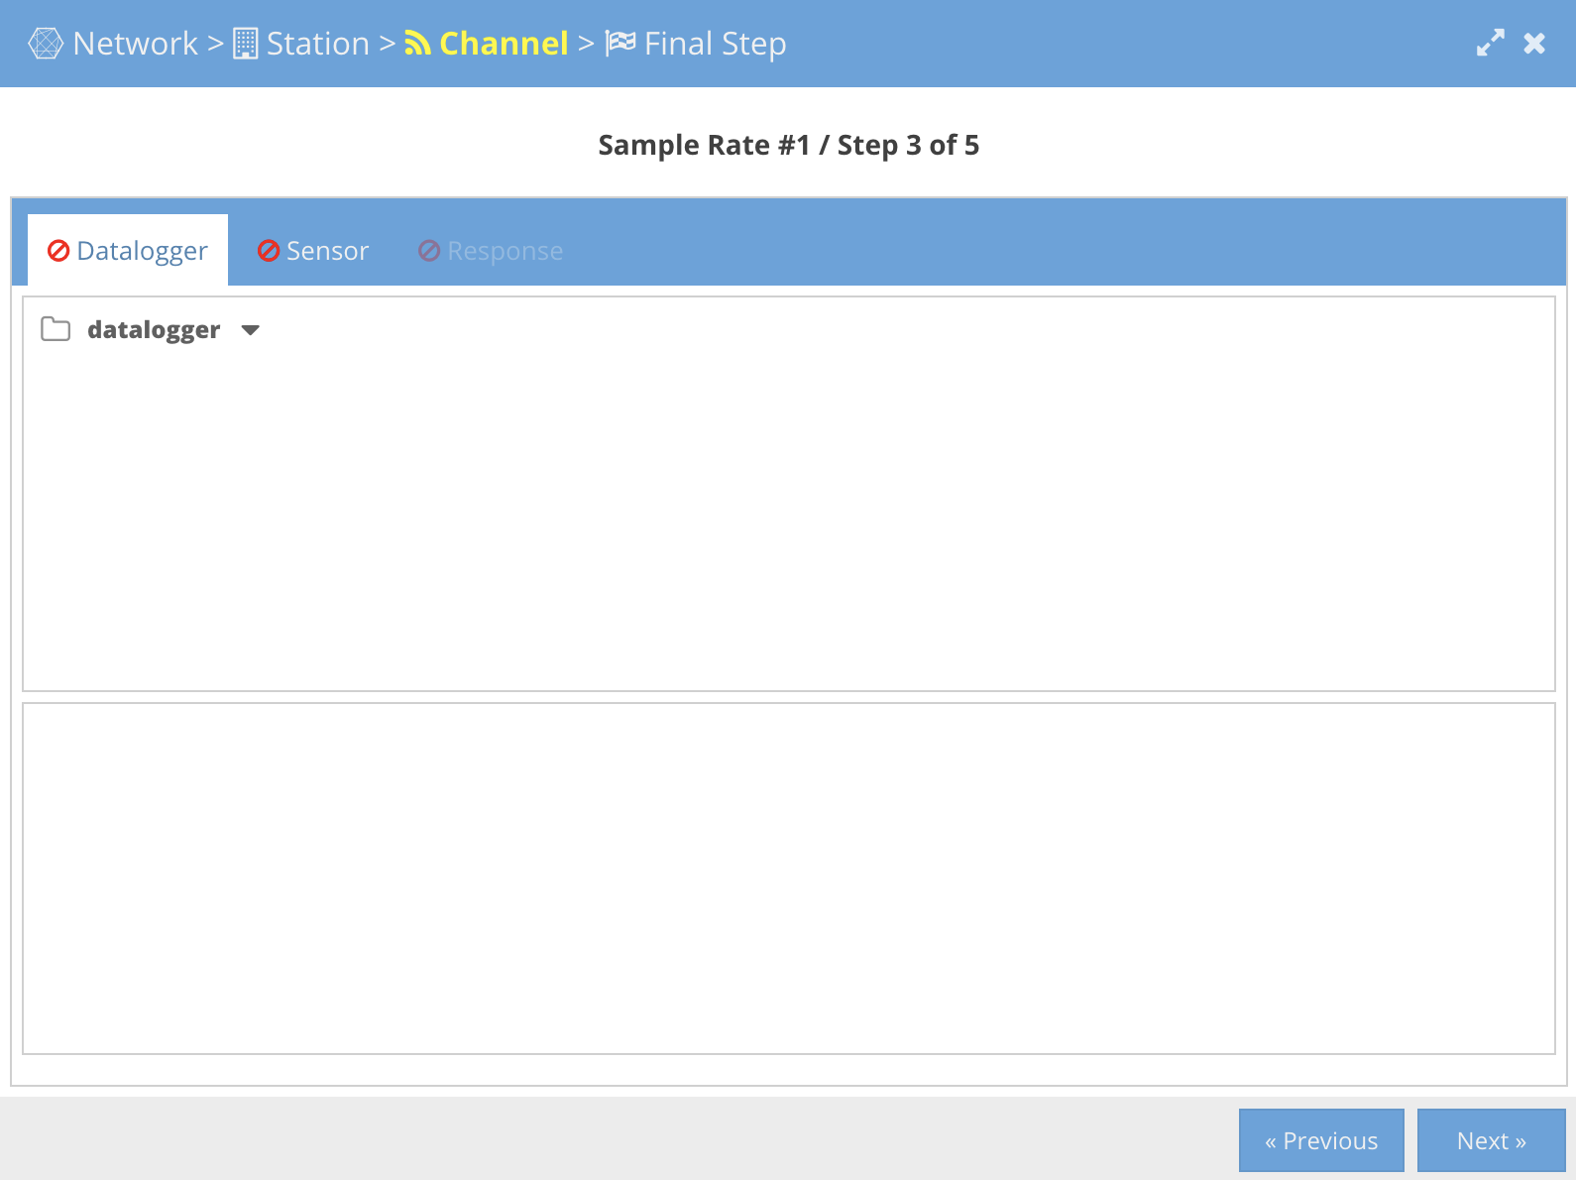
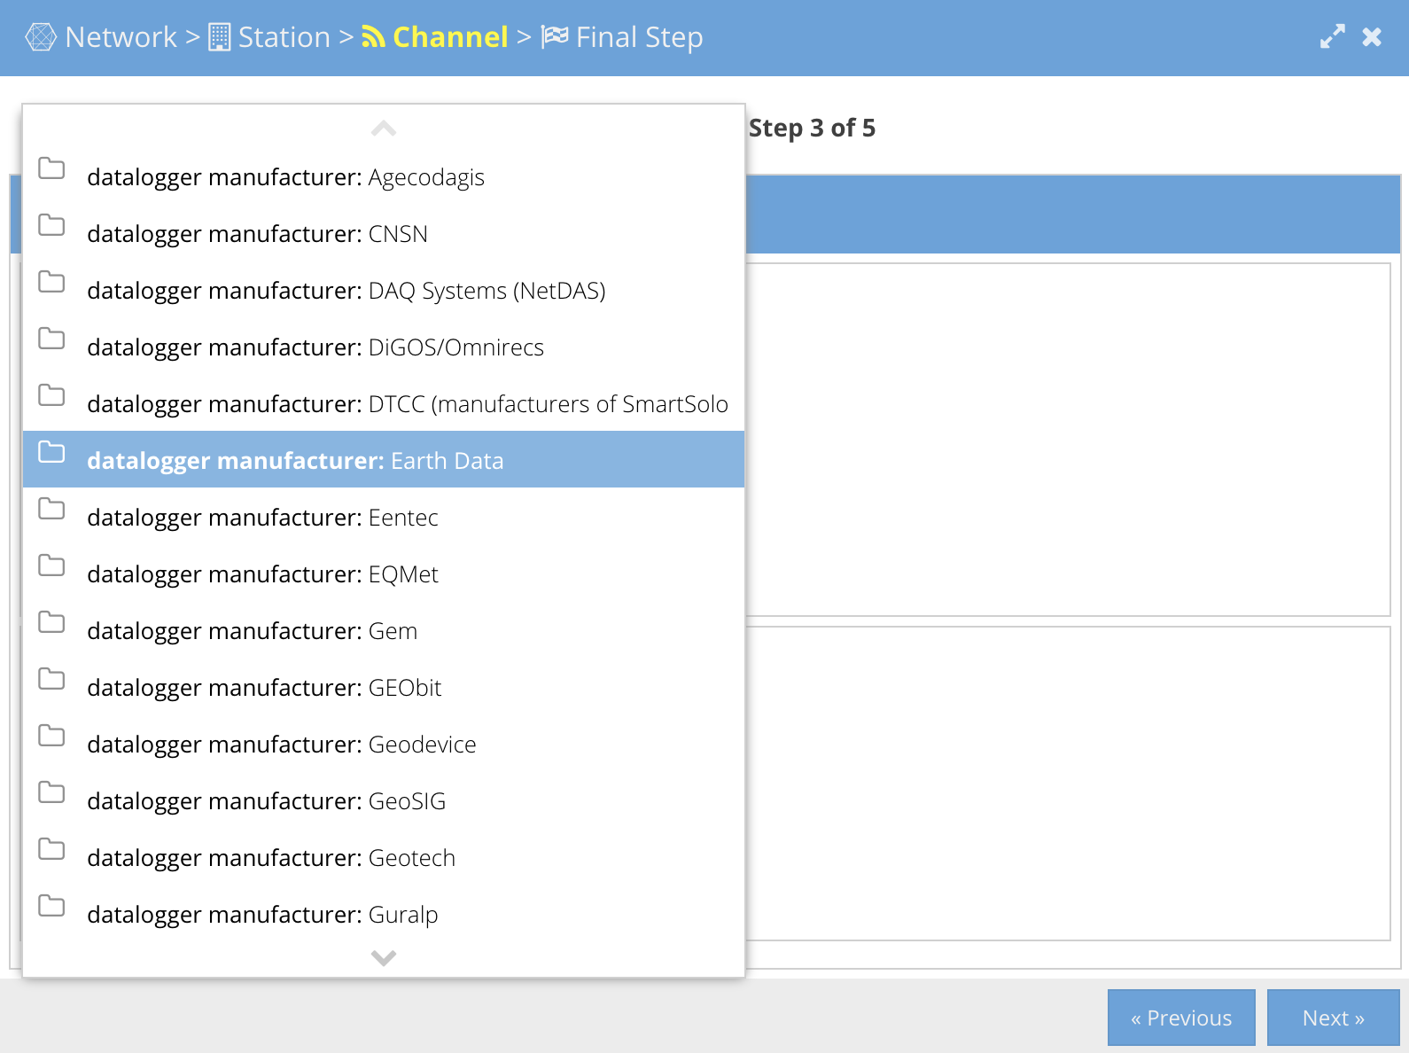
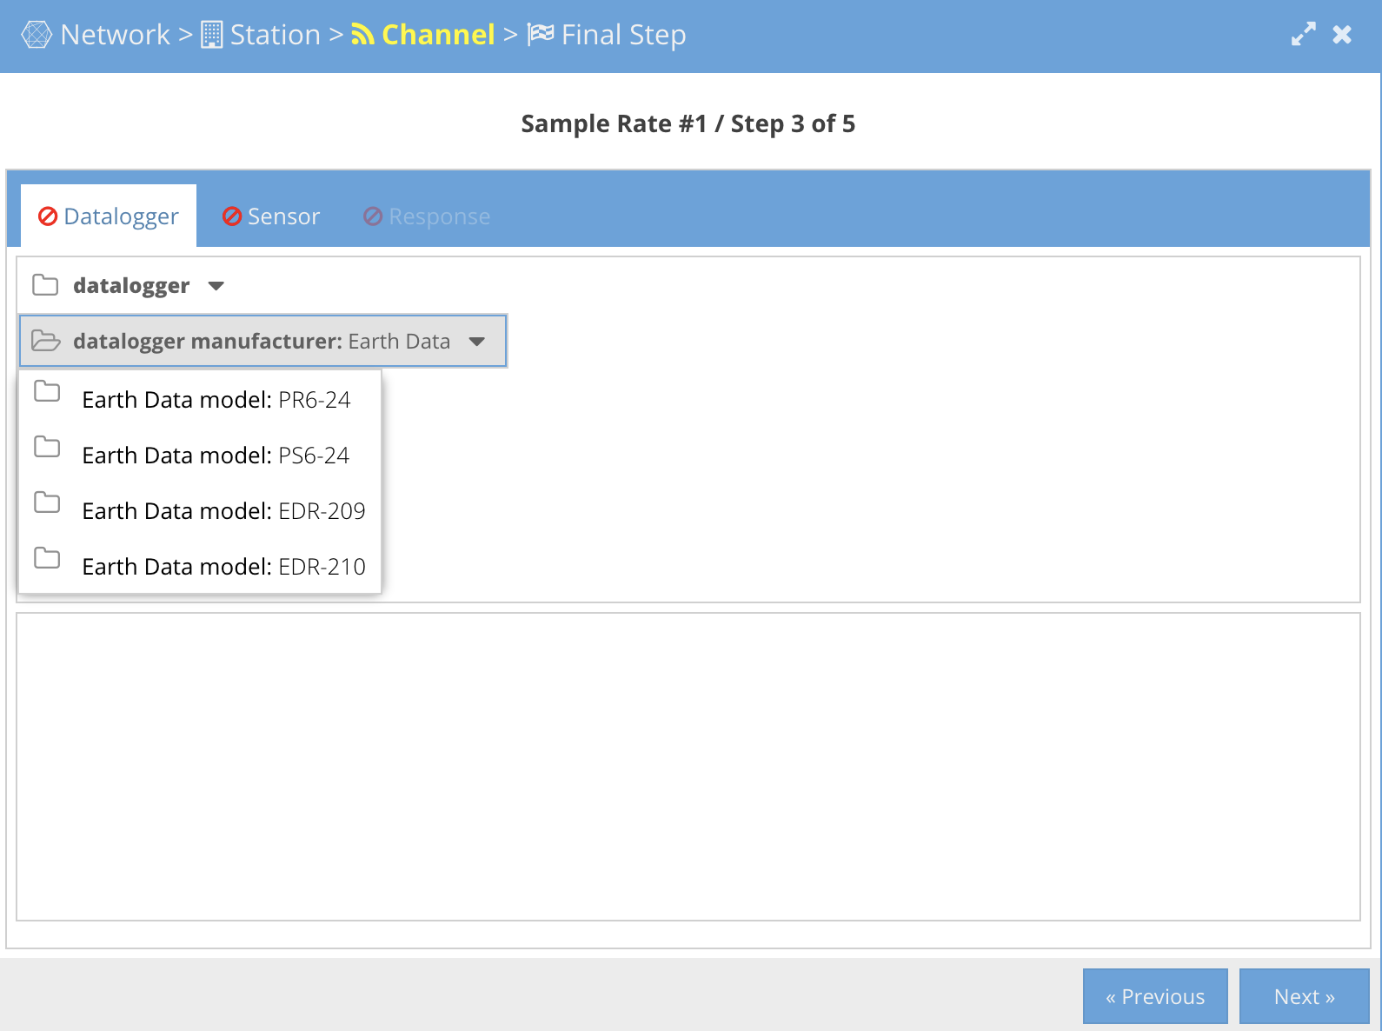
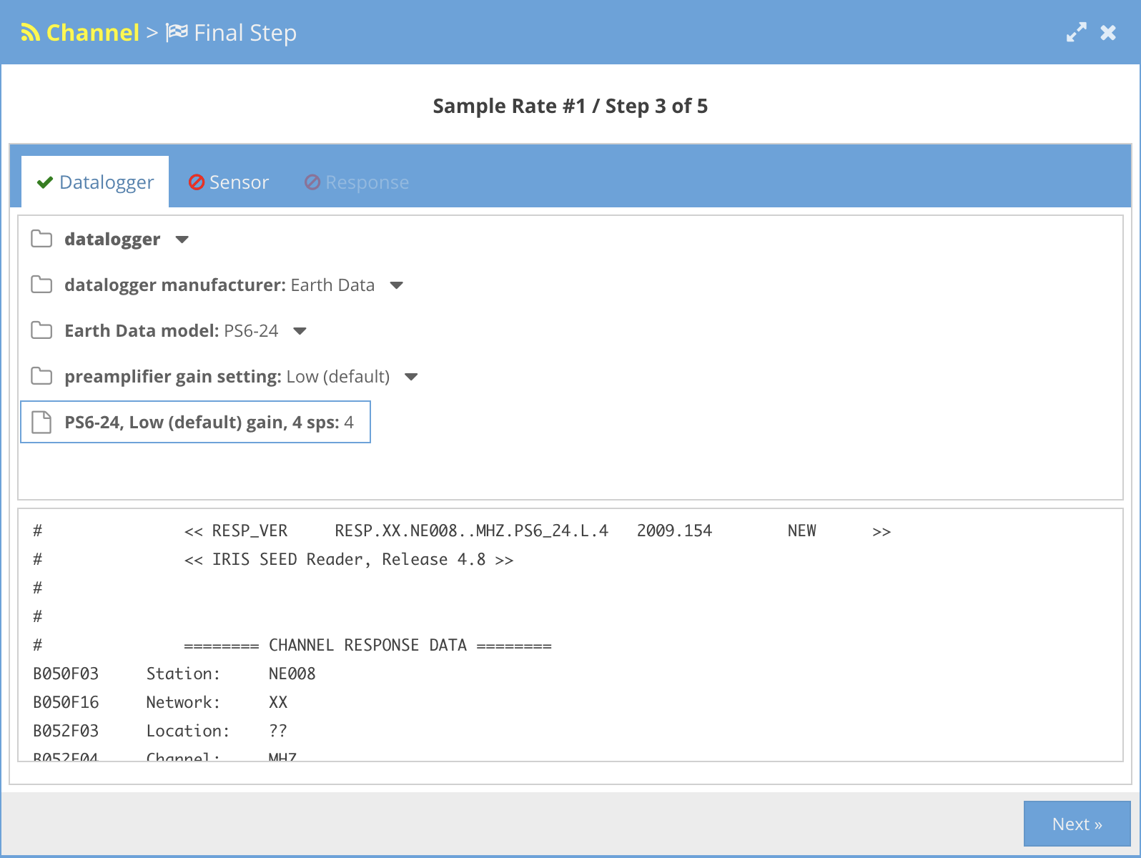
Walking Through the Wizard - NRL Response
Choose datalogger parameters

Slide 38
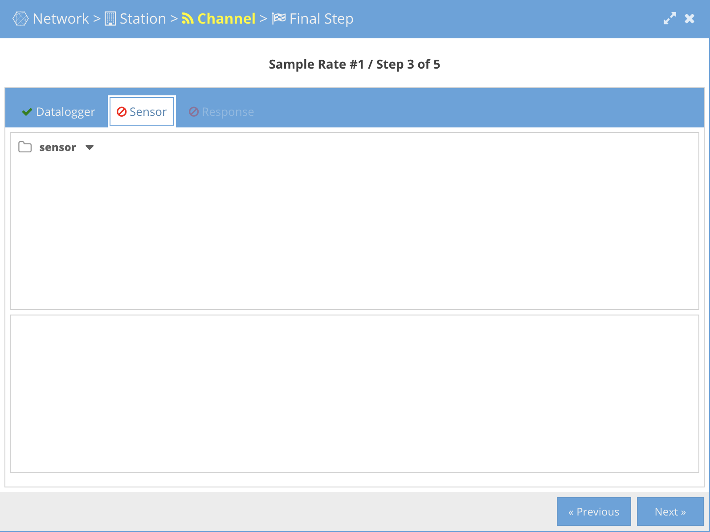
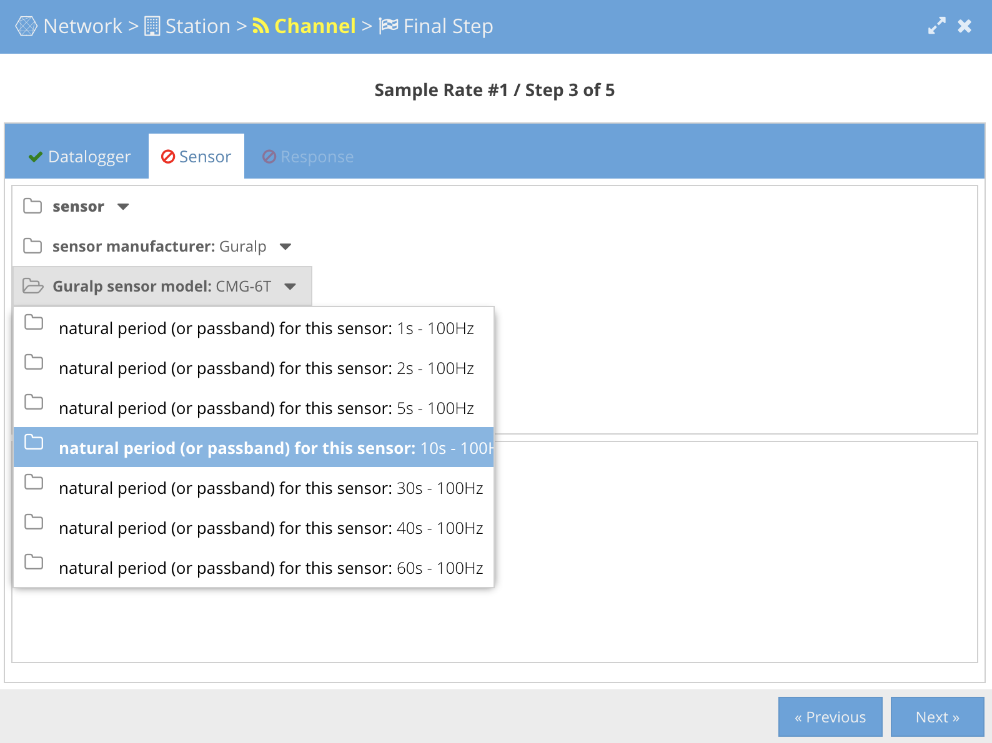
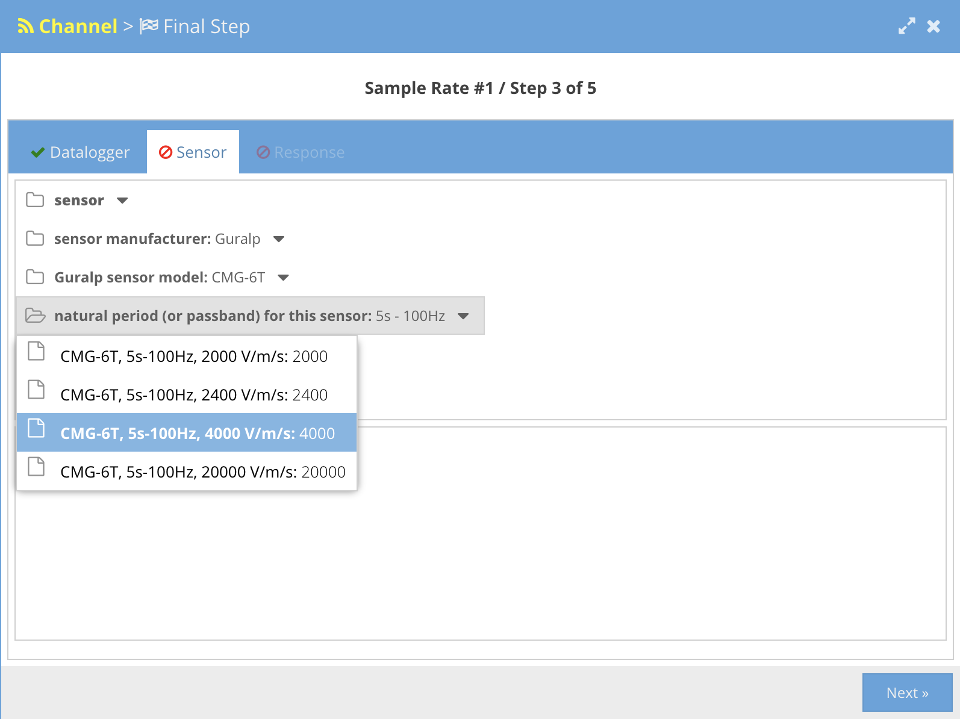
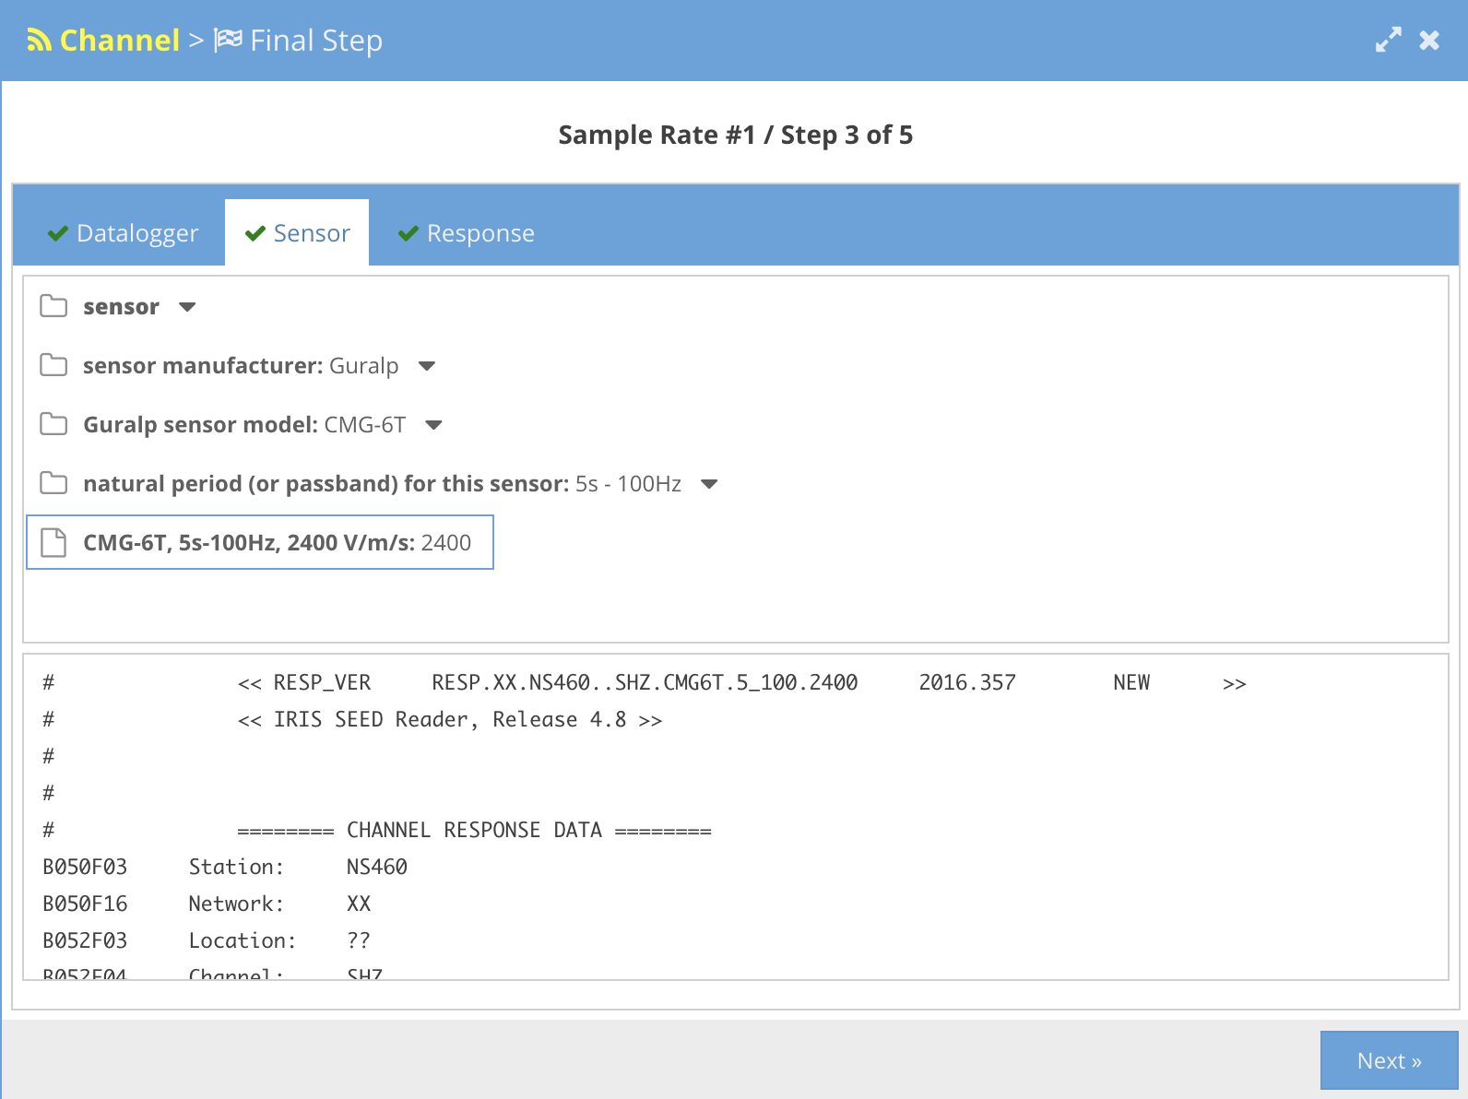
Walking Through the Wizard - NRL Response
Choose sensor parameters

Slide 39
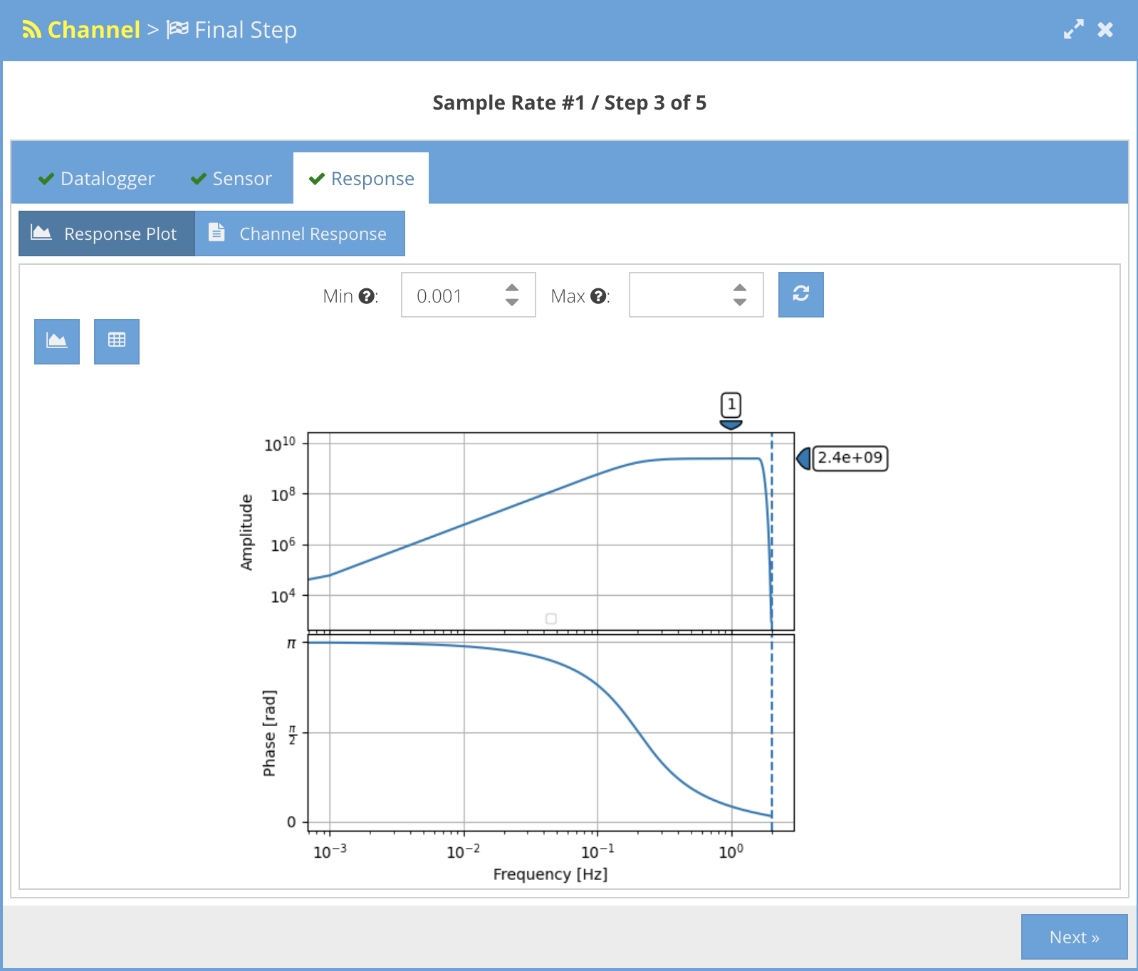
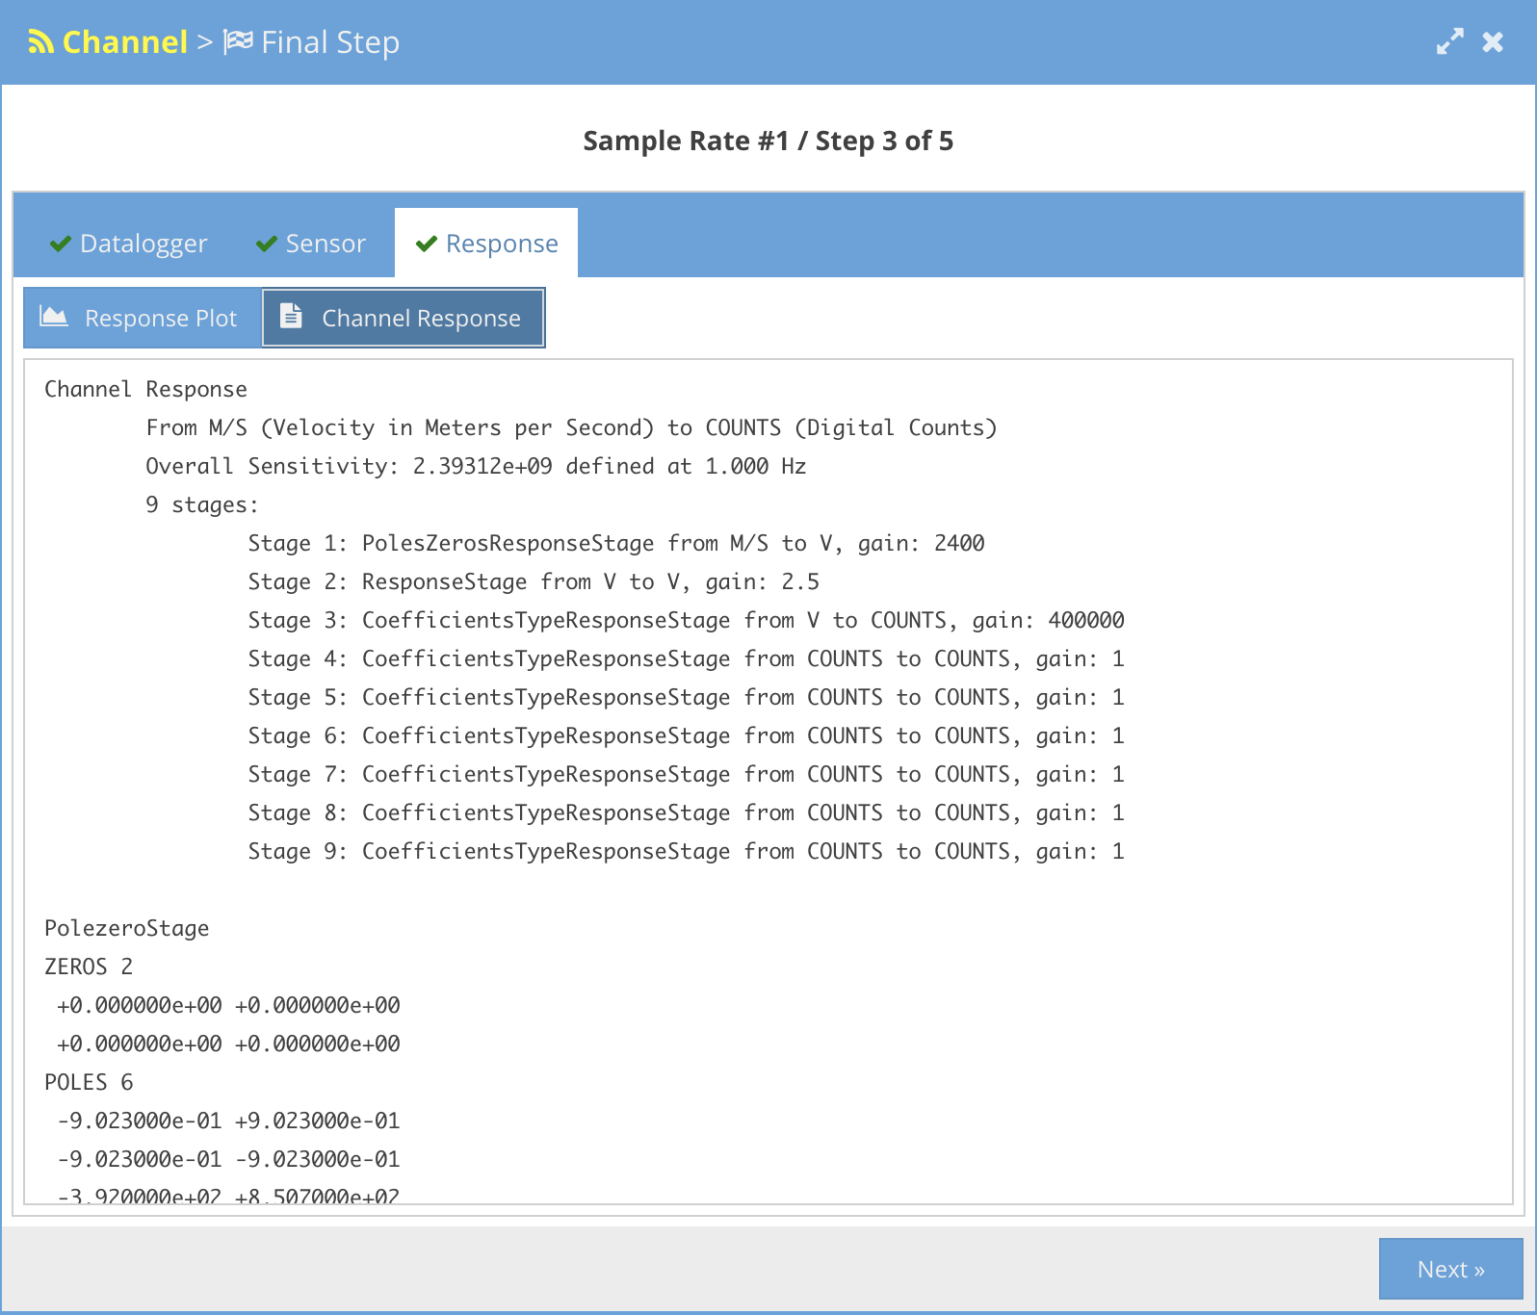
Walking Through the Wizard - NRL Response
Resulting response plot and channel response

Slide 40
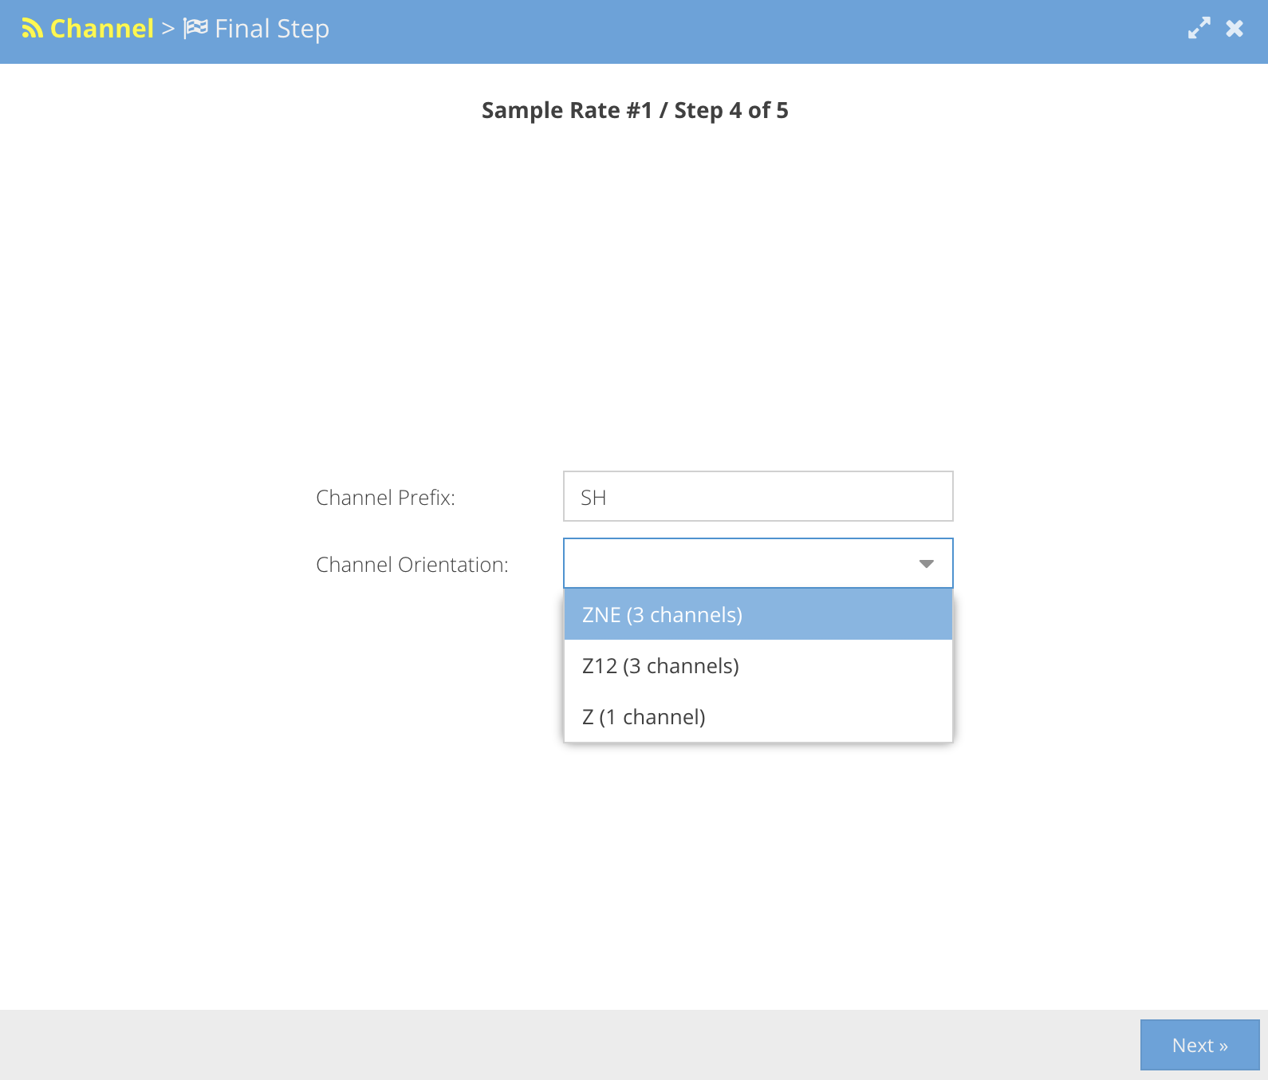
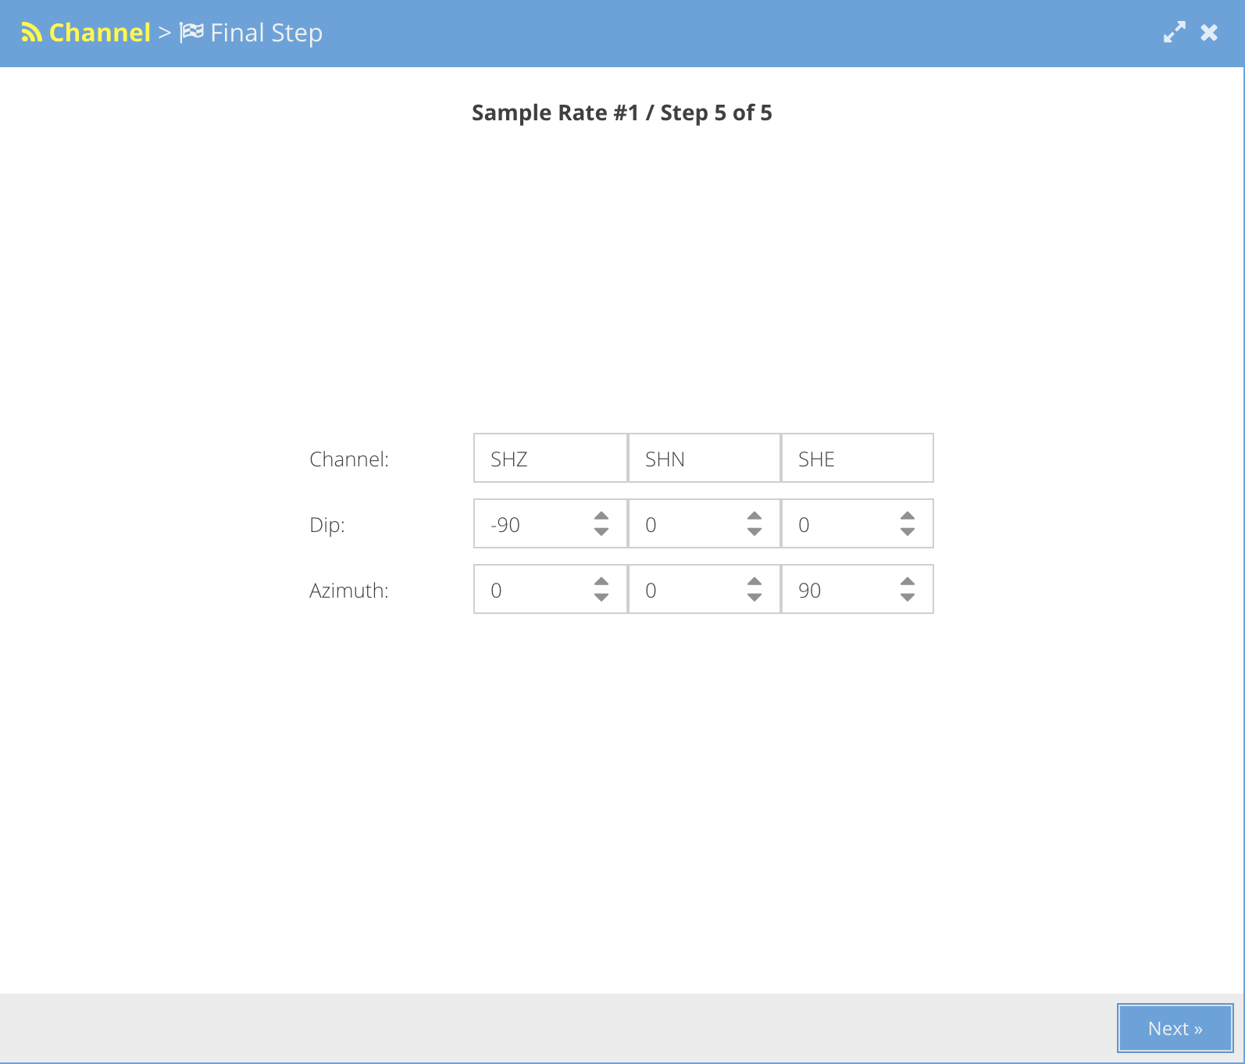
Walking Through the Wizard - NRL Response
Assigning Channels and Orientations

Slide 41
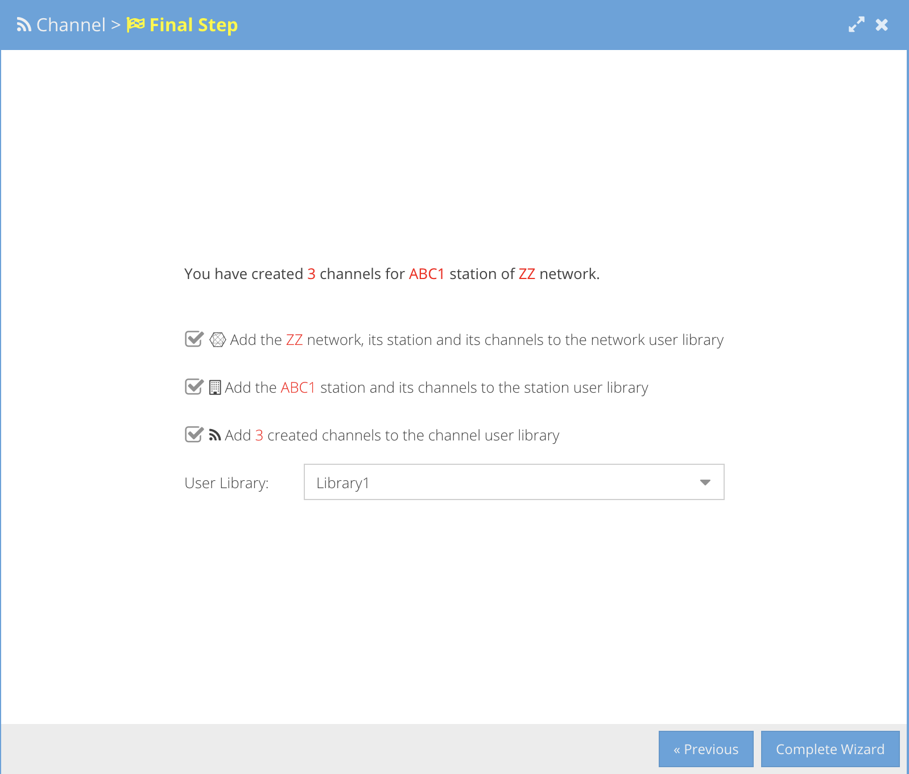
Walking Through the Wizard - NRL Response
Final step - optional addition to Library for later re-use
Notes:
Choosing a response using the AROL Wizard is a similar process

Slide 42
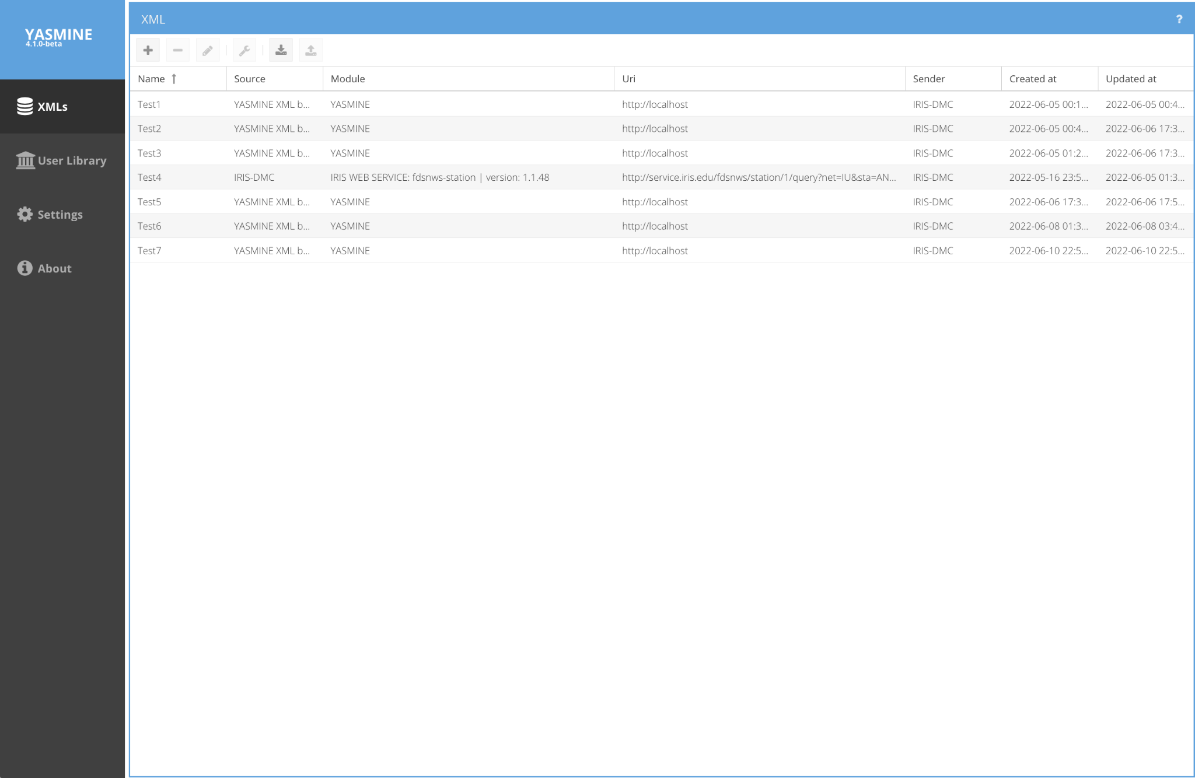
Importing Existing StationXML File

Slide 43
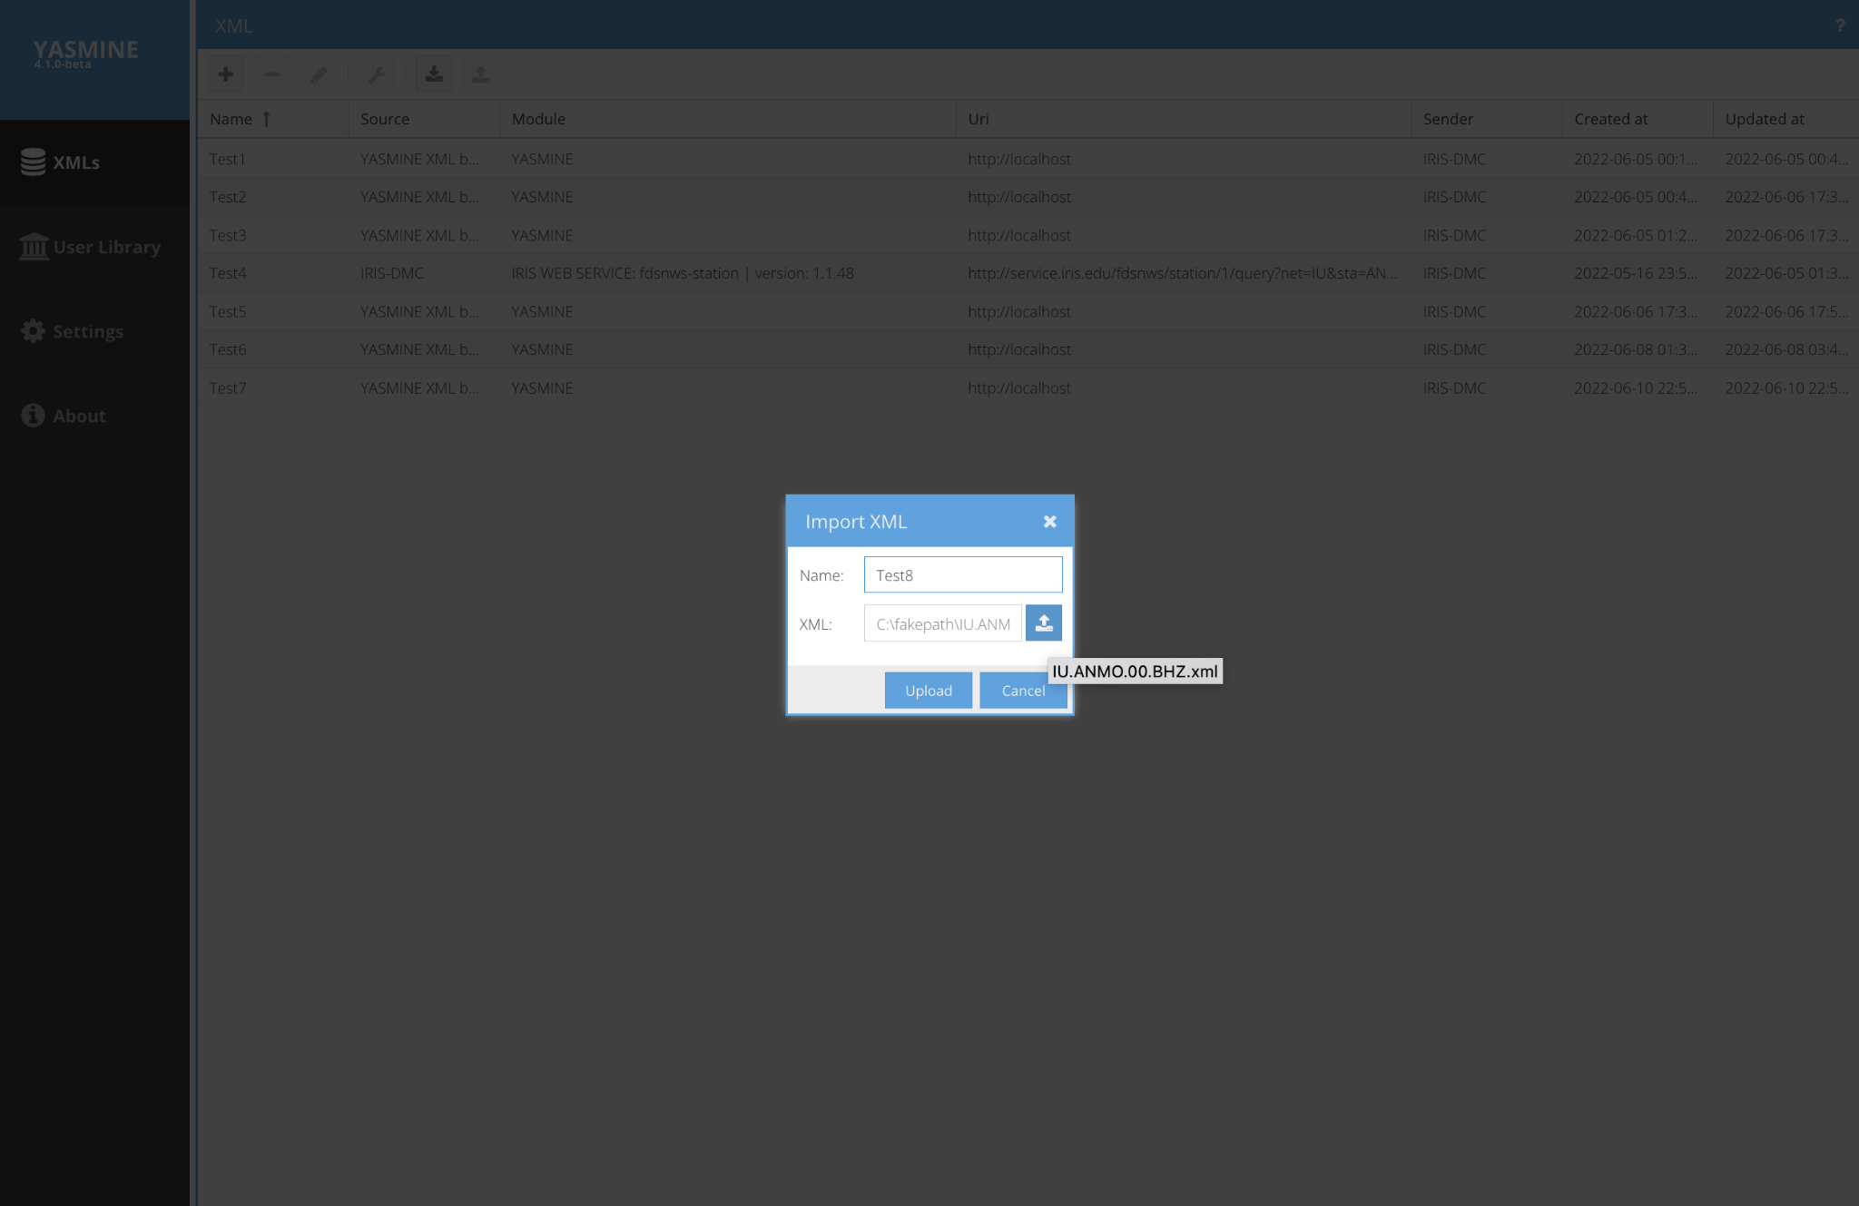
Importing Existing StationXML File

Slide 44
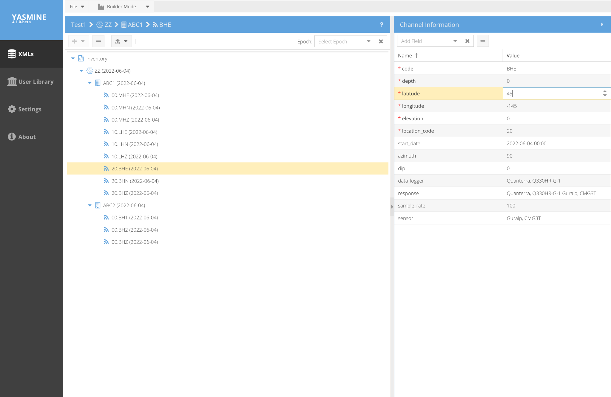
Editing and Adding Information
select the value box to edit
(clicking on the response box will allow you to view the response plot as well as edit)

Slide 45
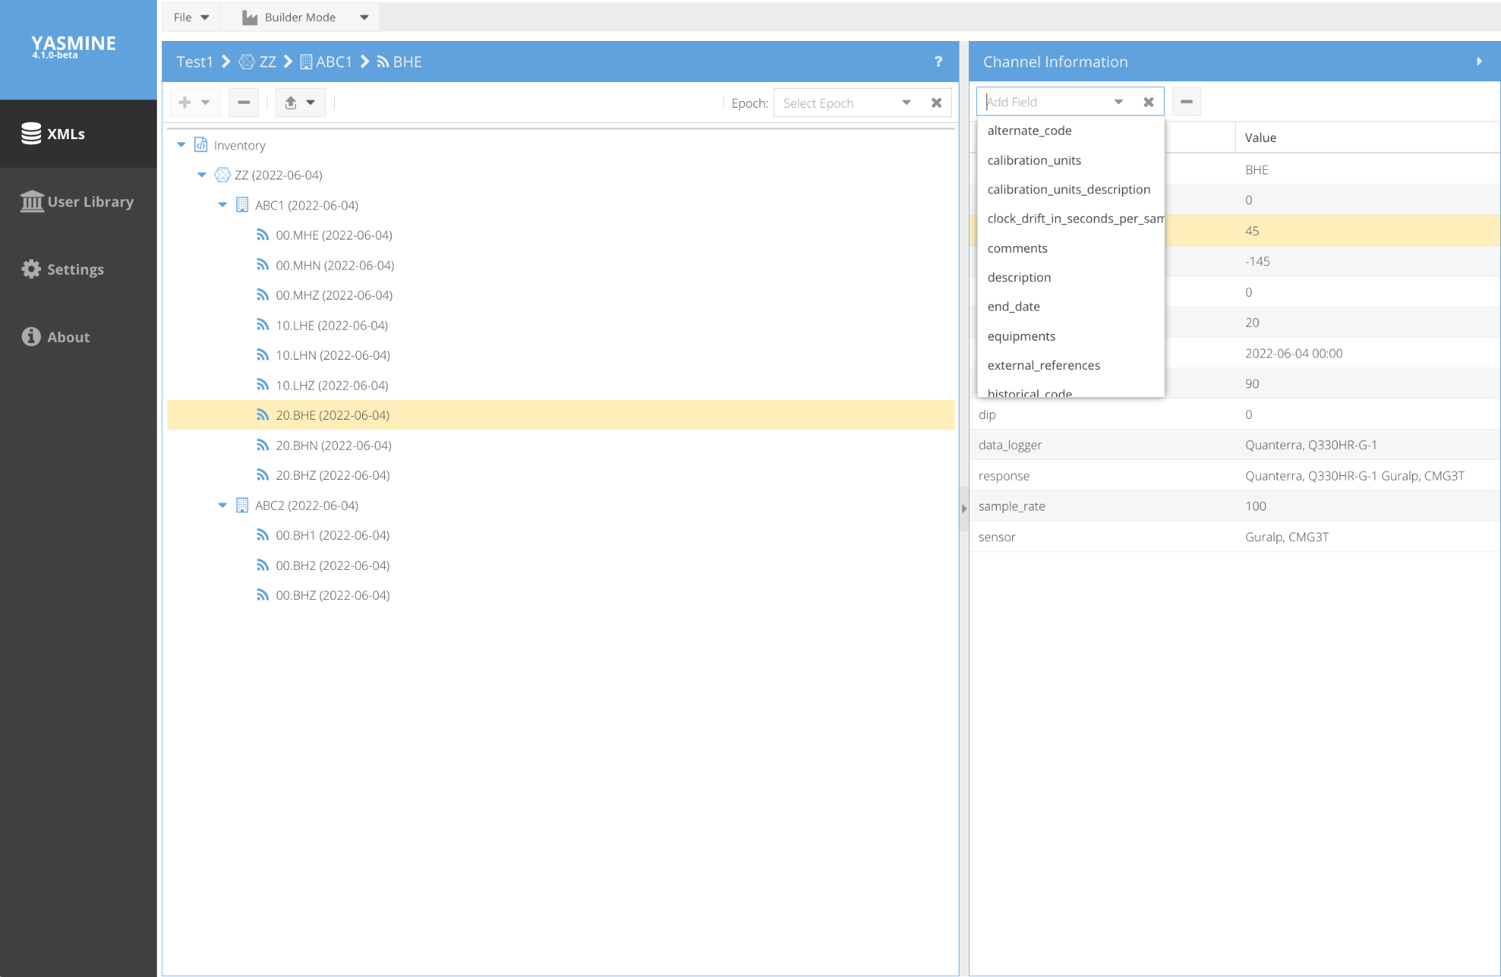
Editing and Adding Information
Choose fields to add
(if you choose ‘response’ here, it launches the NRL/AROL wizard)

Slide 46
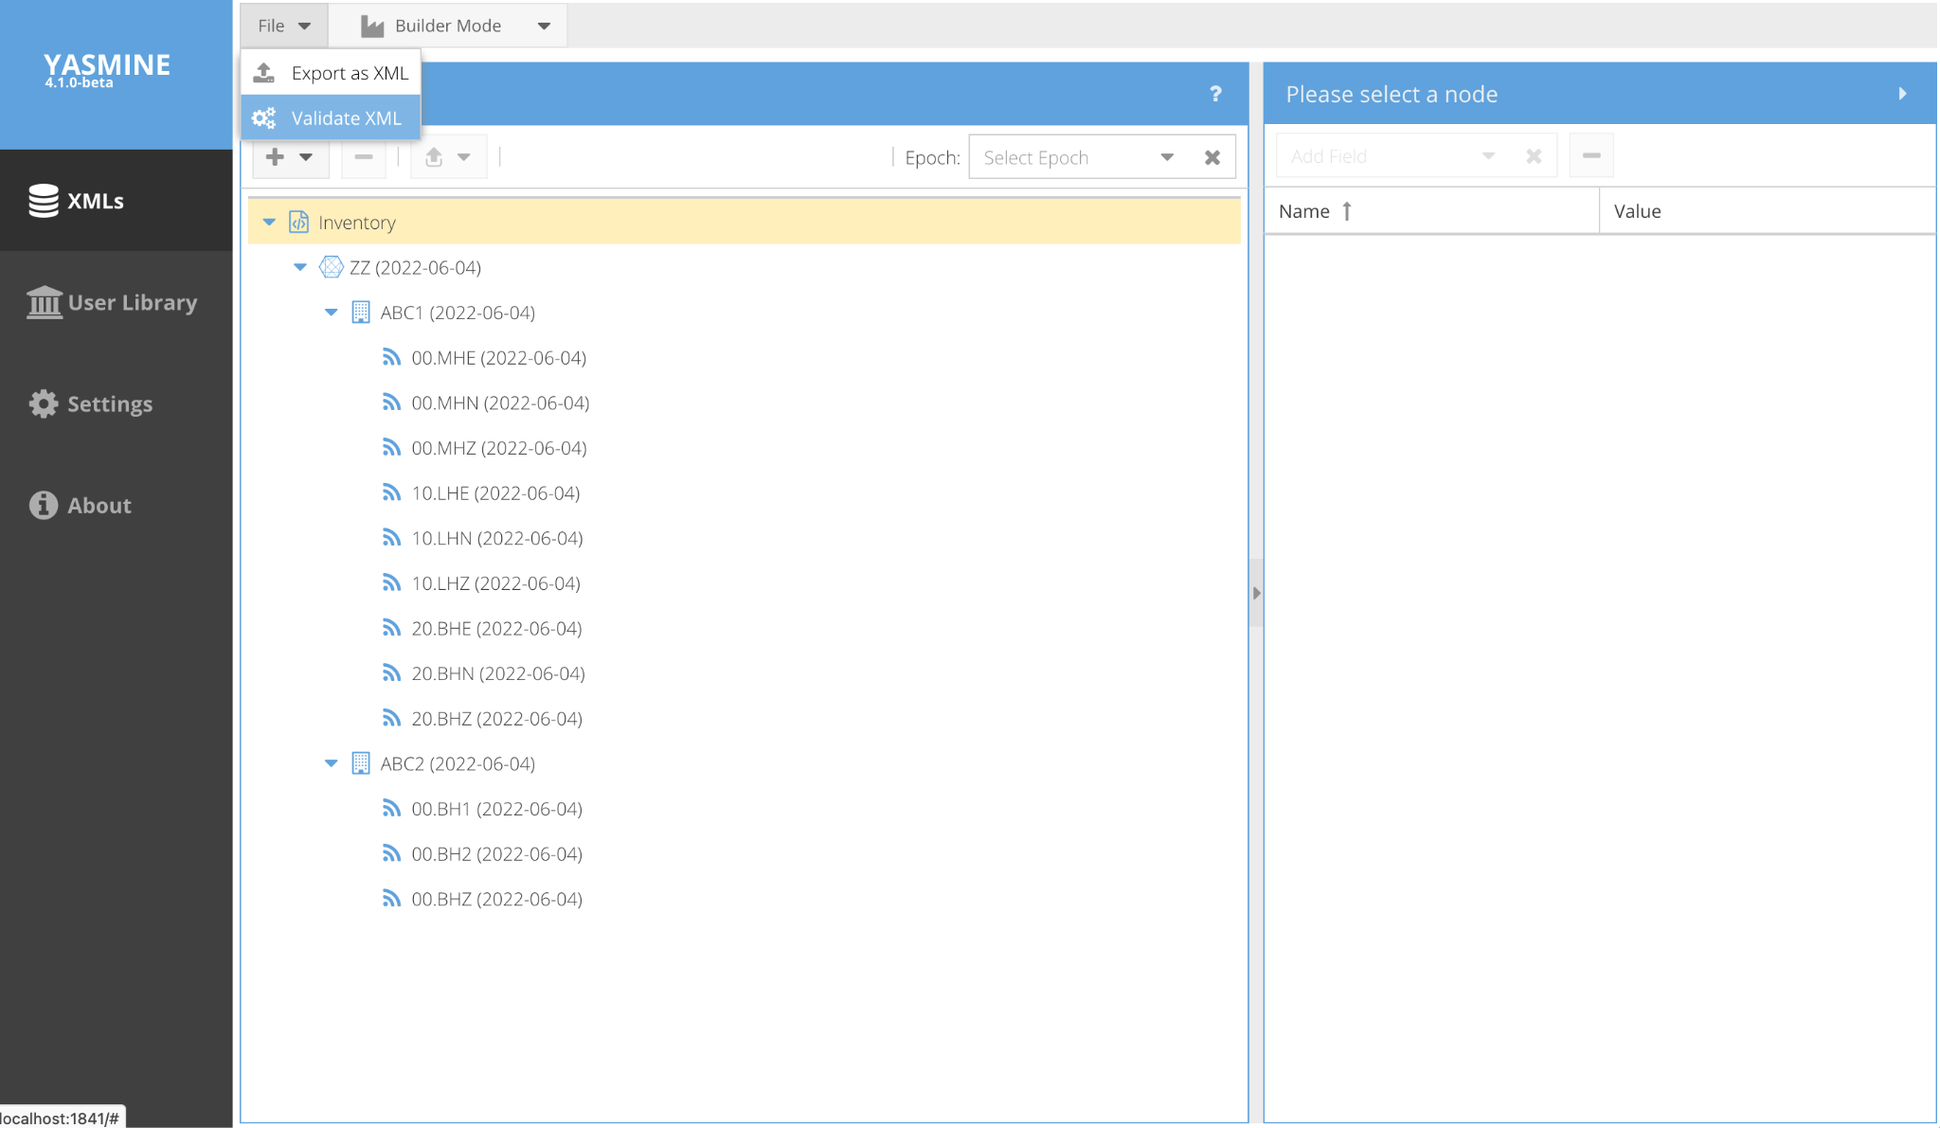
Validation of StationXML
Yasmine validation only extends to the StationXML .xsd schema
More extensive validation to meet IRIS StationXML rules is available at: http://github.com/iris-edu/stationxml-validator

Slide 47
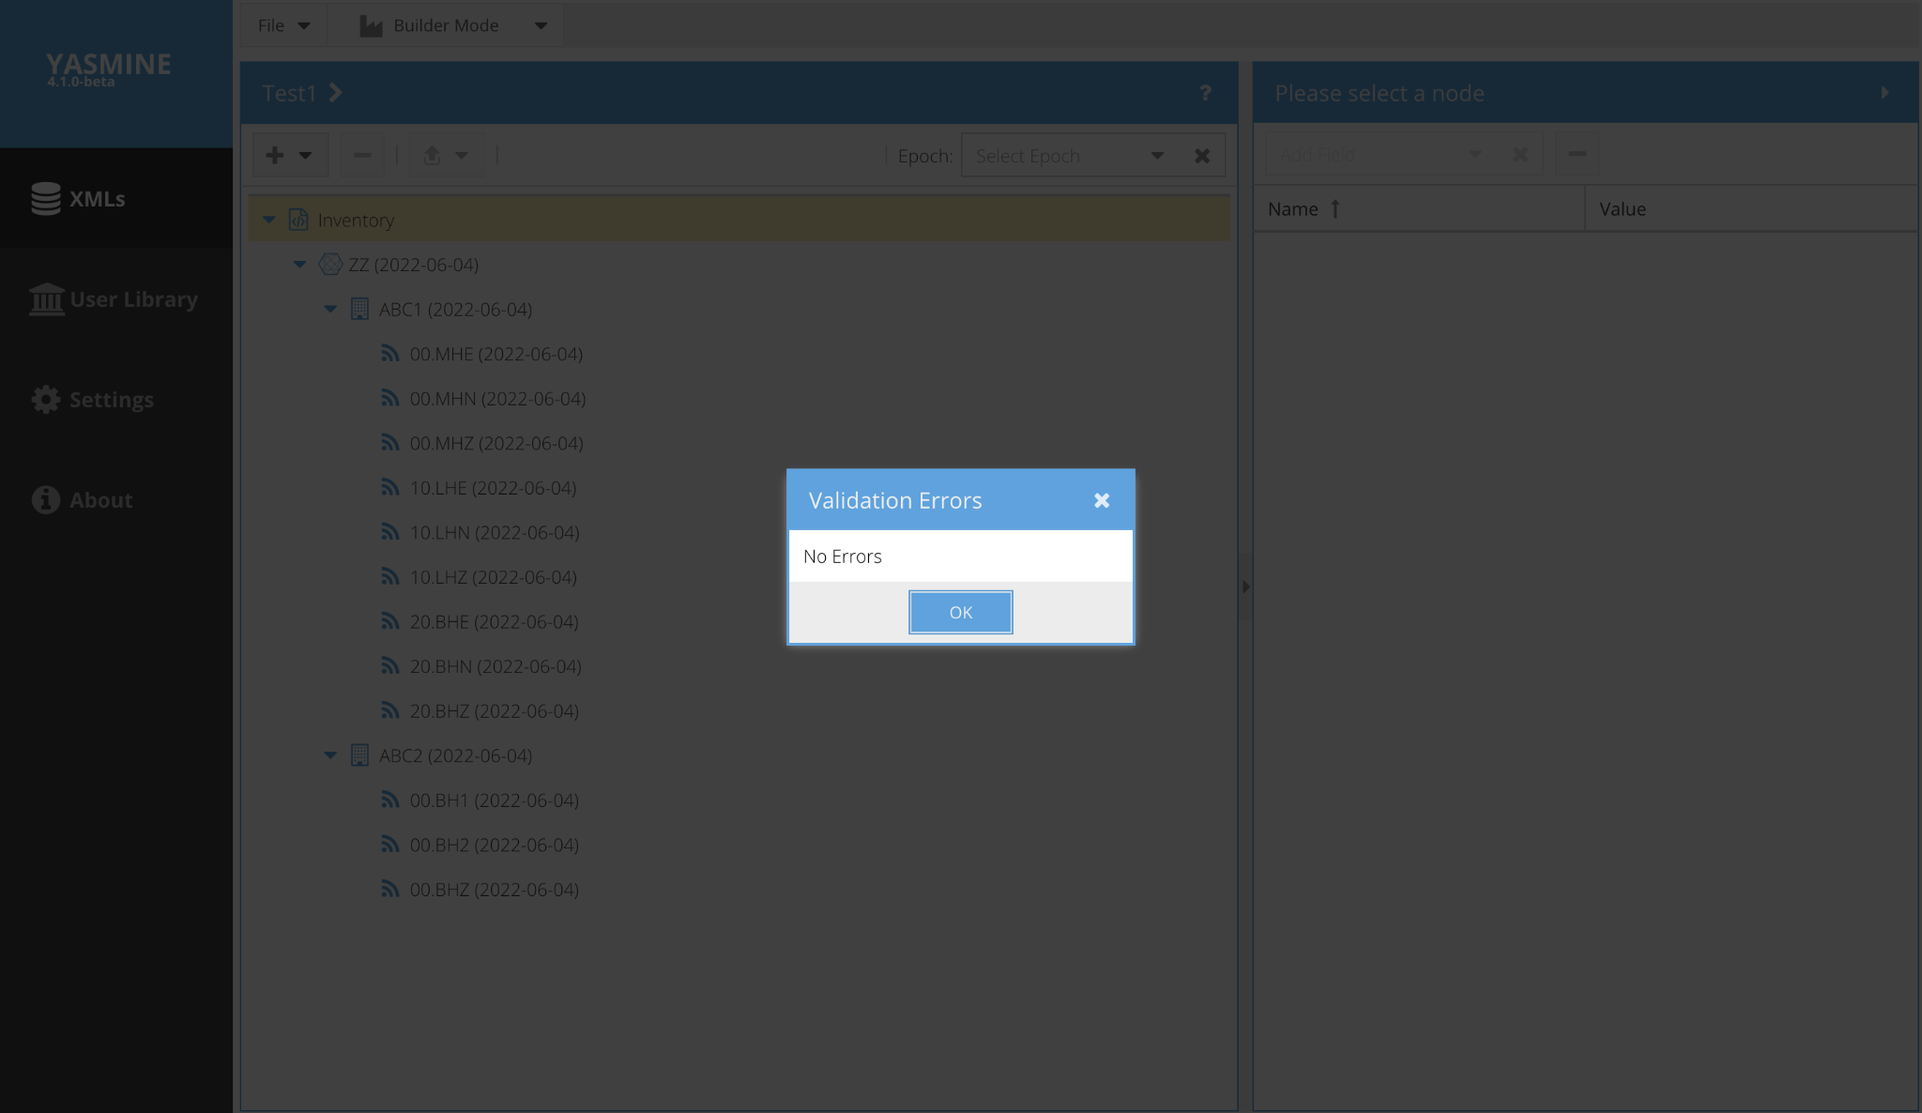
Validation of StationXML
Yasmine validation only extends to the StationXML .xsd schema
More extensive validation to meet IRIS StationXML rules is available at: http://github.com/iris-edu/stationxml-validator

Slide 48
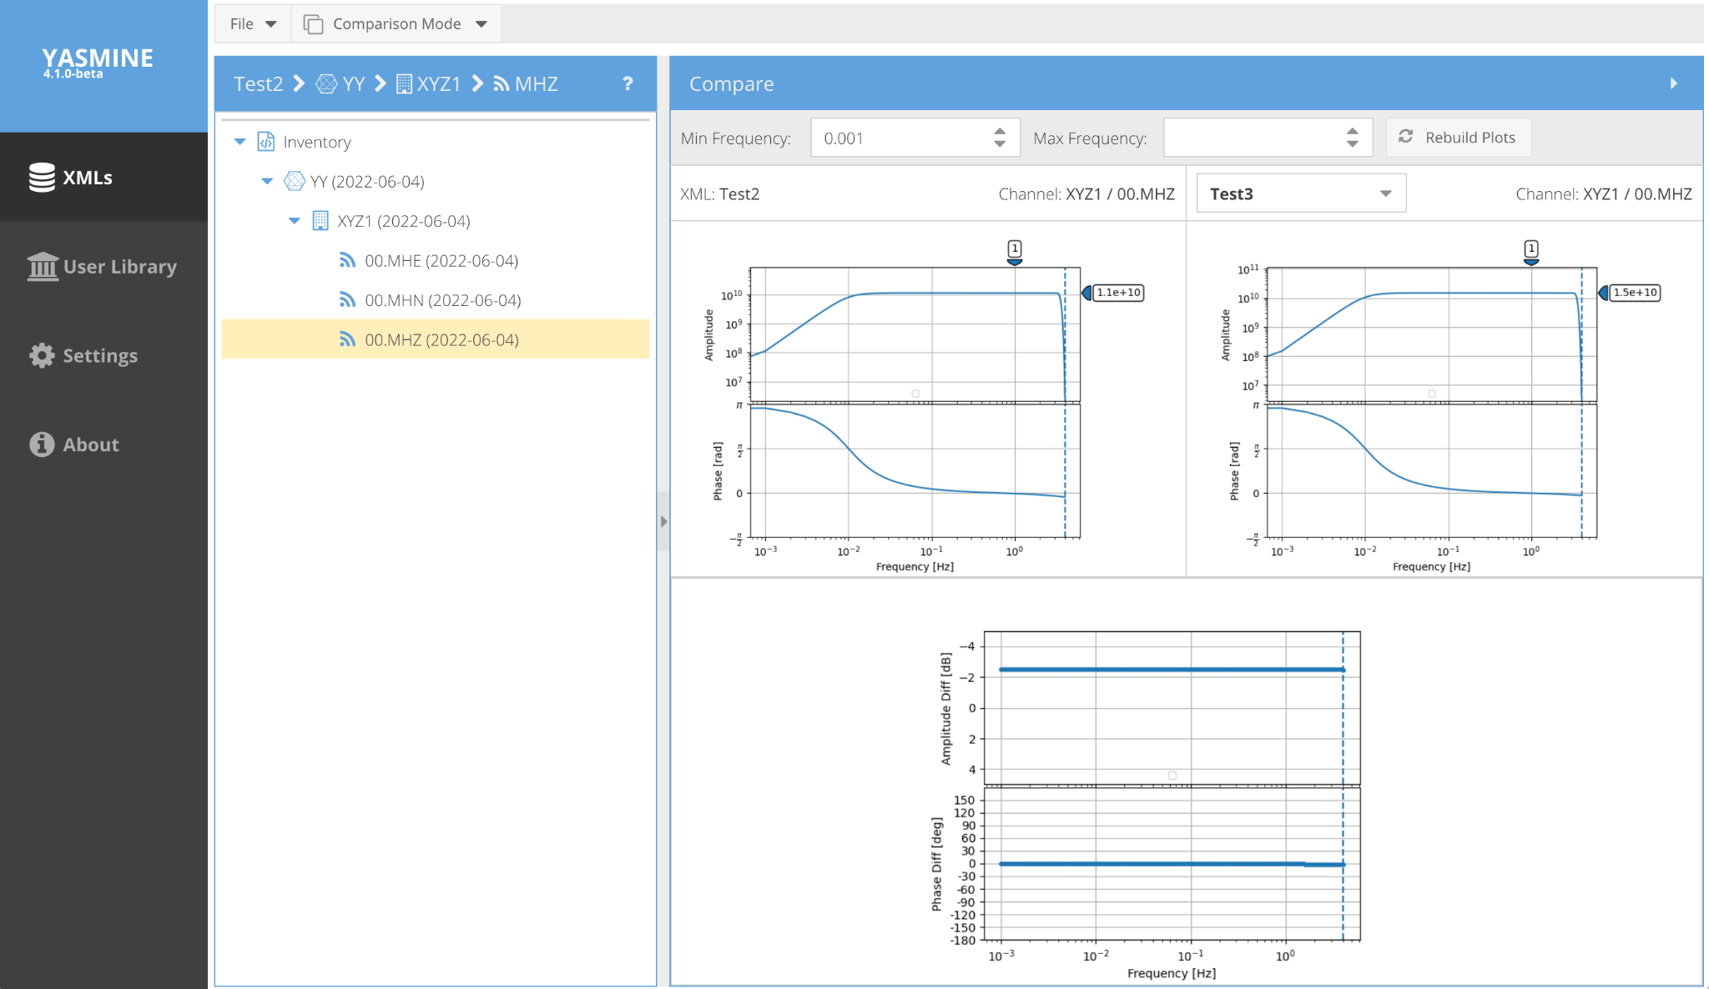
Comparison Mode
must be same network-station-location-channel (SNCL) code
responses to compare must be in different XML files

Slide 49
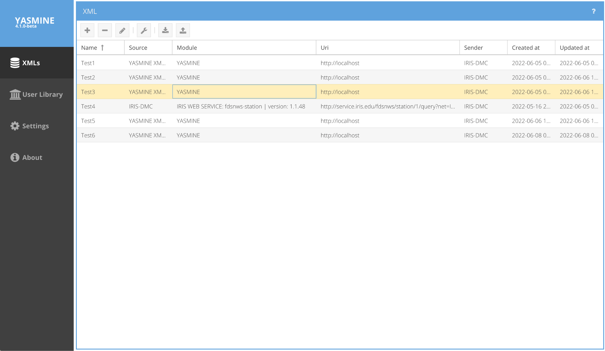
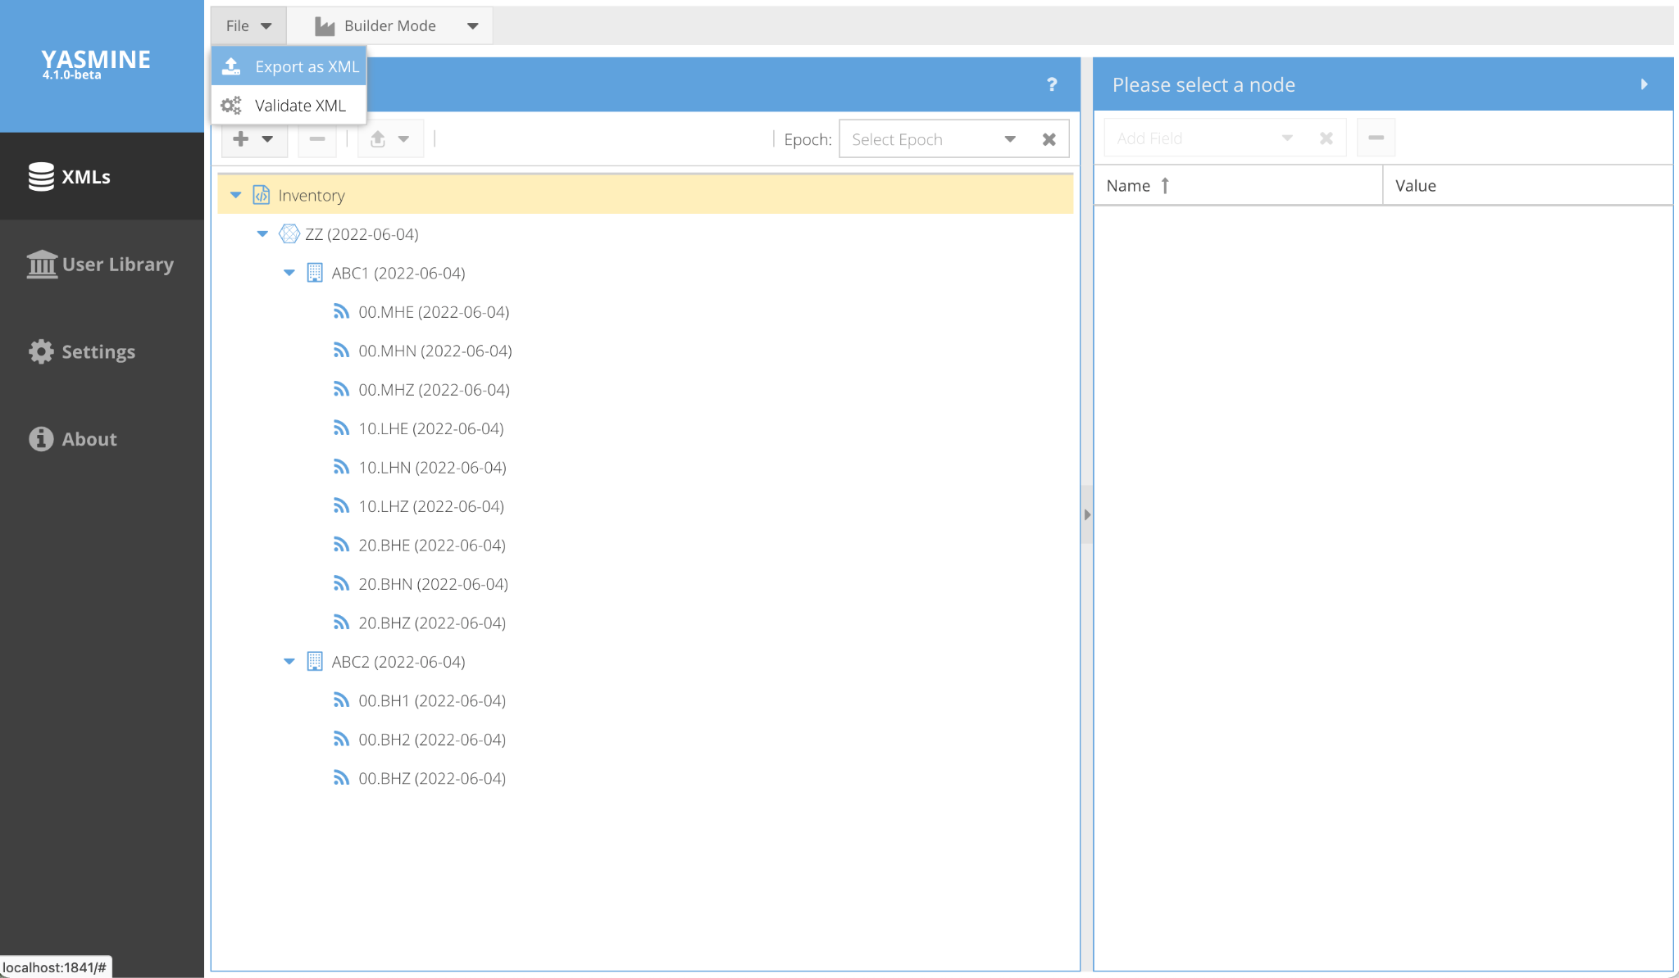
Exporting StationXML
from top-level view
from Builder/Comparison Mode view

Slide 50
Yasmine Editor Demo

Slide 51
Yasmine Editor Exercises
download StationXML from station service (curl command), then import into YASMINE, then edit
wget -O XML1 ‘http://service.iris.edu/fdsnws/station/1/query?net=IU&sta=ANMO&loc=00&cha=BHZ&level=response&format=xml’
creation from wizard, set out parameters for people to use

Slide 52
Yasmine Command Line Interface
batch editing and merging of StationXML files
usage: yasmine-cli [-h | --help]
[--level_network II | --level_station II.* | --level_channel II.ANMO.00.*]
[--action [add/delete/update basenode]]
[--epoch_station int] [--epoch_channel int]
[--field FIELD] [--value VALUE | --from_yml fname.yml]
[--infiles] [-o] [-p] [--print_all] [--dont_validate]
[--schema_version ver] [--show_fields] [--plot_resp]
[--plot_dir path]

Slide 53
Yasmine CLI - Installation
Use for batch editing and merging of StationXML files
1. Create conda environment
(optional, conda available at https://anaconda.org/conda-forge/conda)
> conda create -n yasmine_test python=3.8
> conda activate yasmine_test
2. Install matplotlib backend
> pip install pyqt5
3. Clone the Yasmine CLI Git repository and install:
> git clone https://github.com/iris-edu/yasmine-stationxml-cli
> cd yasmine-stationxml-cli
> pip install .

Slide 54
Yasmine CLI - Levels and Epochs
specify where in the XML document to perform actions
Levels: Network, Station, Channel
--level_network=IU (act on this network)
--level_network=* (act on all networks)
--level_station=IU.ANMO (act on this station)
--level_station=*.ANMO (act on this station in all networks)
--level_station=IU.* (act on all stations in this network)
--level_station=*.* (act on all stations in all networks)
--level_channel=IU.ANMO.00.BHZ (act on this channel)
--level_channel=IU.ANMO.00.* (act on all channels at this location code)
--level_channel=IU.ANMO.*.* (act on all channels at all location codes)
--level_channel=IU.*.*.* (act on all channels of all stations of this network)
--level_channel=*.*.*.* (act on all channels of all stations of all networks)

Slide 55
Yasmine CLI - Levels and Epochs
specify where in the XML document to perform actions
Epochs: stations or channels
--epoch_station=int (act on fields in this station epoch index number)
eg, --epoch_station=1
--epoch_channel=int (act on fields in this channel epoch index number)
eg, --epoch_channel=0

Slide 56
Yasmine CLI - Input/Output
specify input files and output to file or standard out
--infiles comma separated list of input xml files
-o, --output name of output xml file [default=stdout]
-p, --print print out sorted Station/Channel epochs
--print_all print out sorted Station/Channel epochs + operator/comment lists

Slide 57
Yasmine CLI - Actions
specify how to modify or act on the XML document
Actions: Add, Delete, Select, Update
add a new basenode object (network, station, channel) from a .yml file
--action=add --from_yml=yml:/path/to/file.yml --infiles=...
Example channel.yml file Channel:
code: 'HN1'
location_code: '30'
description: 'This is an added channel'
start_date: 2006-06-30T20:00:01.000000Z
end_date: 2399-12-31T23:59:59.000000Z
latitude: 34.945911
longitude: -106.457199
elevation: 1820.0
depth: 0.0
azimuth: 90.0

Slide 58
Yasmine CLI - Actions
specify how to modify or act on the XML document
Actions: Add, Delete, Select, Update
delete basenode object(s) at specified level
--action=delete --level_network=IU --infiles=... (delete all stations from network)
--action=delete --level_station=IU.ANMO --infiles=... (delete all channels from station)

Slide 59
Yasmine CLI - Actions
specify how to modify or act on the XML document
Actions: Add, Delete, Update, Select
update the value of a basenode field or insert value if missing
set with --field and --value
where values of type double, int, string can be specified on the command line
or else contained in a .yml file
--action=update --field=latitude --value=45 --level_station=IU.ANMO --infiles=...
--action=update --field=data_availability --value=yml:yml/dataavailability.yml --level_station=IU.ANMO --infiles=...

Slide 60
Yasmine CLI - Actions
specify how to modify or act on the XML document
Actions: Add, Delete, Update, Select
filter for basenode object(s) that match the SNCL at specified level
--action=select --level_station=IU.ANMO --infiles=... (filter for all station codes matching ‘ANMO’)
If no action is specified, the action will default to update if --field and --value are specified
or to select otherwise

Slide 61
Yasmine CLI - Other Options
--dont_validate turn OFF StationXML validation on all inputs/outputs
--schema_version ver {1.0, 1.1}
--show_fields print out allowable --field, + --value combinations
--show-fields print out allowable --field, + --value combinations
--plot_resp plot all channel responses
--plot_dir path path to dir to save plot responses
--loglevel log level log level in {DEBUG, INFO, WARN, etc}

Slide 62
Yasmine CLI - Examples
> python yasmine-cli.py --level_network=II --field=description --value='Network description' --infiles=...
> python yasmine-cli.py --level_station=II.* --field=latitude --value=34.97 --infiles=...
> python yasmine-cli.py --level_channel=II.ANMO.00.* --field=comments[0] --value=yml:/path/comment.yml --infiles=...
> python yasmine-cli.py --level_network=* --action=add --from_yml=path/to/station.yml --infiles=...

Slide 63


